Slide 1

When All Else Fails-
ECMO for Trauma
Is It Time?

Slide 2
Shock
Cell ischemia from global inadequate O2 delivery
  Goal is stop the cause, restore flow, prevent consequences
Stopping bleeding more important than volume repletion
  Hypotensive resuscitation
  Damage control operations
Notes:
What kills most trauma patients? That’s why ABCD comes first Airway pneuma bleed brain

Slide 3
23yo GSW left chest
10 min transport scoop and run
  80/palpable, pulse 150, R-30, GCS 13
  Pulse lost in ambulance bay
Intubated, finger thoracotomy on right, resuscitative thoracotomy left, no tamponade, 800cc blood in left chest and spewing up from diaphragm
Aorta clamped and rhythm return
  To OR

Slide 4
OR course
Lap and medial visceral rotation to repair aortic injury beween celiac and SMA, then posterior vena cava. Small bowel.
Bleeding controlled
Massive blood loss
Worsening pO2/FiO2 ratio and acidosis and lactate
Unable to maintain BP

Slide 5
OR Course
Chest and abdomen packed
Heart noted to have poor contractility and is becoming dilated
Maximal pressors
Open CPR
Lungs worse and can’t maintain pO2
Expires from irreversible shock
  “he ran out of gas”
Notes:
Had the holes patched, plenty of volume, ran out of gas

Slide 6
What is irreversible in irreversible shock?
Acidosis?
  Bicarb pretty cheap
No preload to pump?
  Holes are fixed and vessels full
Adrenal collapse?
  Giving Epi and steroids
Anemic?
  Hct is 25
Electrolytes?
  Normal
Energy
Bankruptcy
Notes:
What he really has is energy backruptcy. He is out of gas

Slide 7
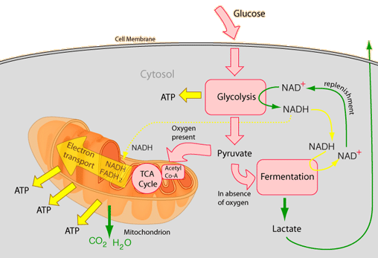
CellularRespiration:
Aerobic
Glucose
Cell membrane
36
net
Notes:
Why do we need oxygen? Remember what it does. A fire smothers without O2, so do we because we need it to mke energy to keep us running.
Follow a glucose molecule

Slide 8
CellularRespiration:
Anaerobic
Lactate
released
Glucose
Cell membrane
2 net
ATP
Notes:
Why do we need oxygen? Remember what it does. A fire smothers without O2, so do we because we need it to mke energy to keep us running.
Follow a glucose molecule
Lactate builds up. Lactic acidosis- lactate not bad just unfinished combustion.
When yu get your car inspected they look at the exaust to make sure you are burning the right mixture of air and gas. If not combusting it yyou are releasing hydroarbons unnecessarily. Same here, Unable to burn the fuel so this is the left overs.

Slide 9
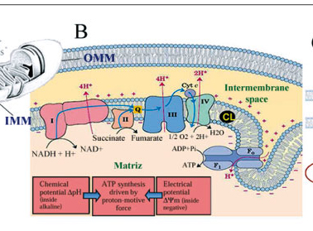
Electron transport proteins
Notes:
Carry electrons safely through to join with oxygen and create energy.
Problem is with hypoxia and no acceptor the electrons build up and when any O2 is available start jumping off leading to free radicles cell damage and ultimatley death

Slide 10
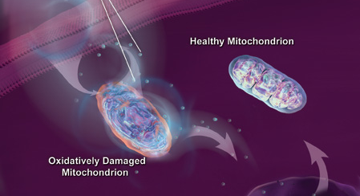
Too little O2 too late

Slide 11
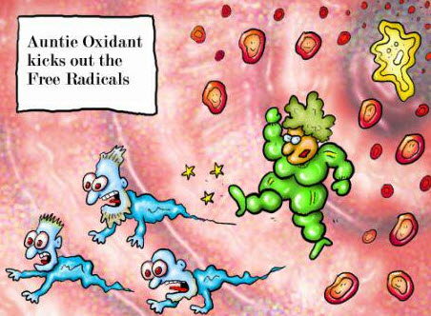
Modulation of the apoptosis process
Notes:
Can yu slow the explosion with reperfusion?? Carbon monoxide poisonus< hydrogen sulphide poison? Cyanide poison? Nitric oxide poison? Indeed all are. So why does our body produce minute amounts of them?
May be here to slow the reving engin with reperfusion by blocking electron flow or slowing the transmittal keep the mitochondrium from dying and saves the ell.
Already doing with hypothermia post arrest.

Slide 12
Resuscitation problem
Patient stressed to the maximum of their physiology
Now we ask for the tissue to do more.. Push through this period of global hypoxia, reperfusion and oxygen debt. How?
Drive the maximally stressed, energy depleted heart to do more???

Slide 13
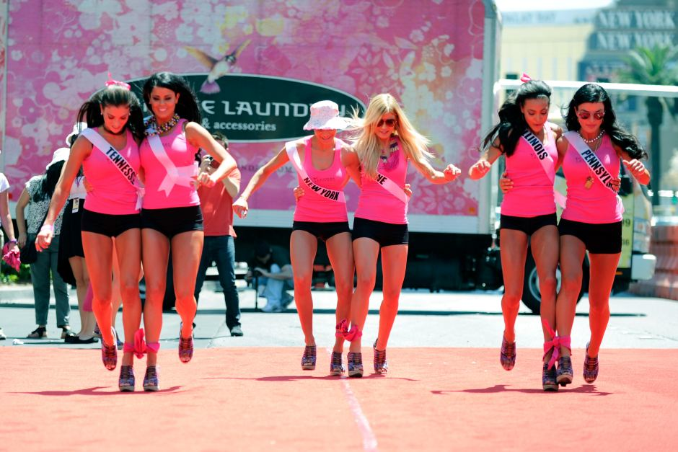
Resuscitation

Slide 14
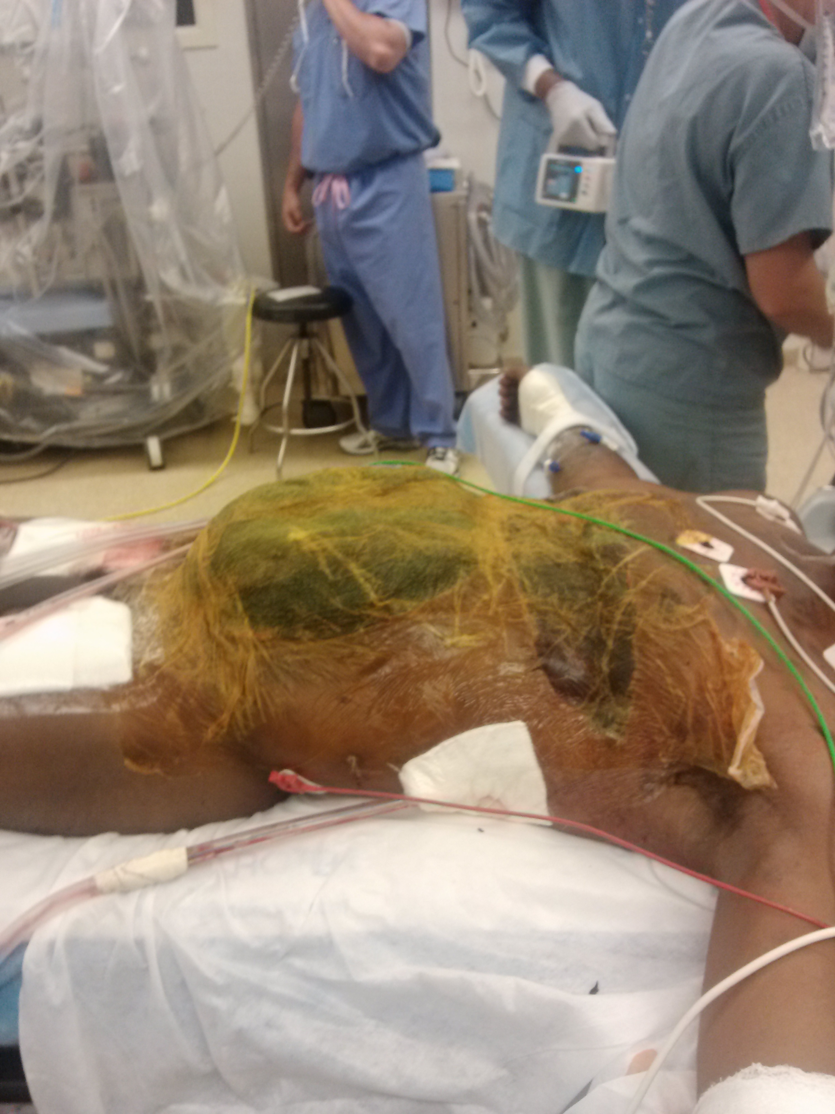
If I can’t change the rules of the game, can I change the tokens we are playing with?

Slide 15
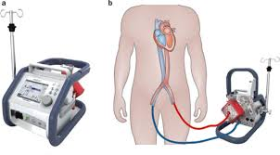
Extracorporeal membrane oxygenation (ECMO)
Form of partial cardiopulmonary bypass used for respiratory and/or cardiac support
Notes:
56% of the 5437 adult patients survived ECMO usage

Slide 16
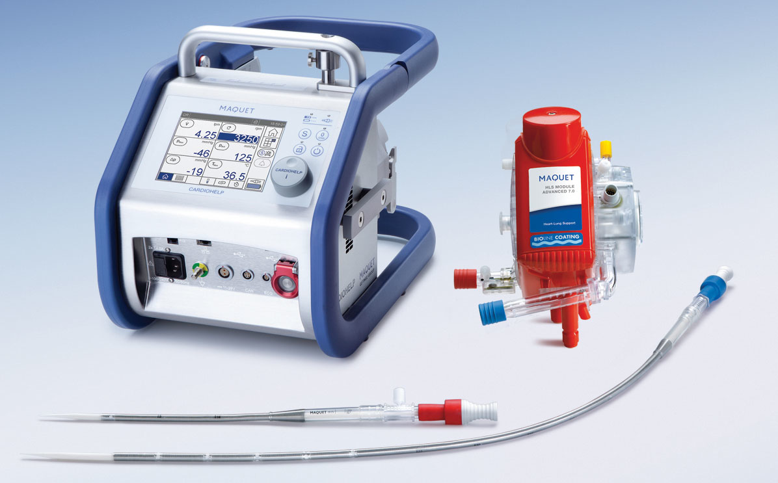
Notes:
CardioHelp 20 pounds

Slide 17
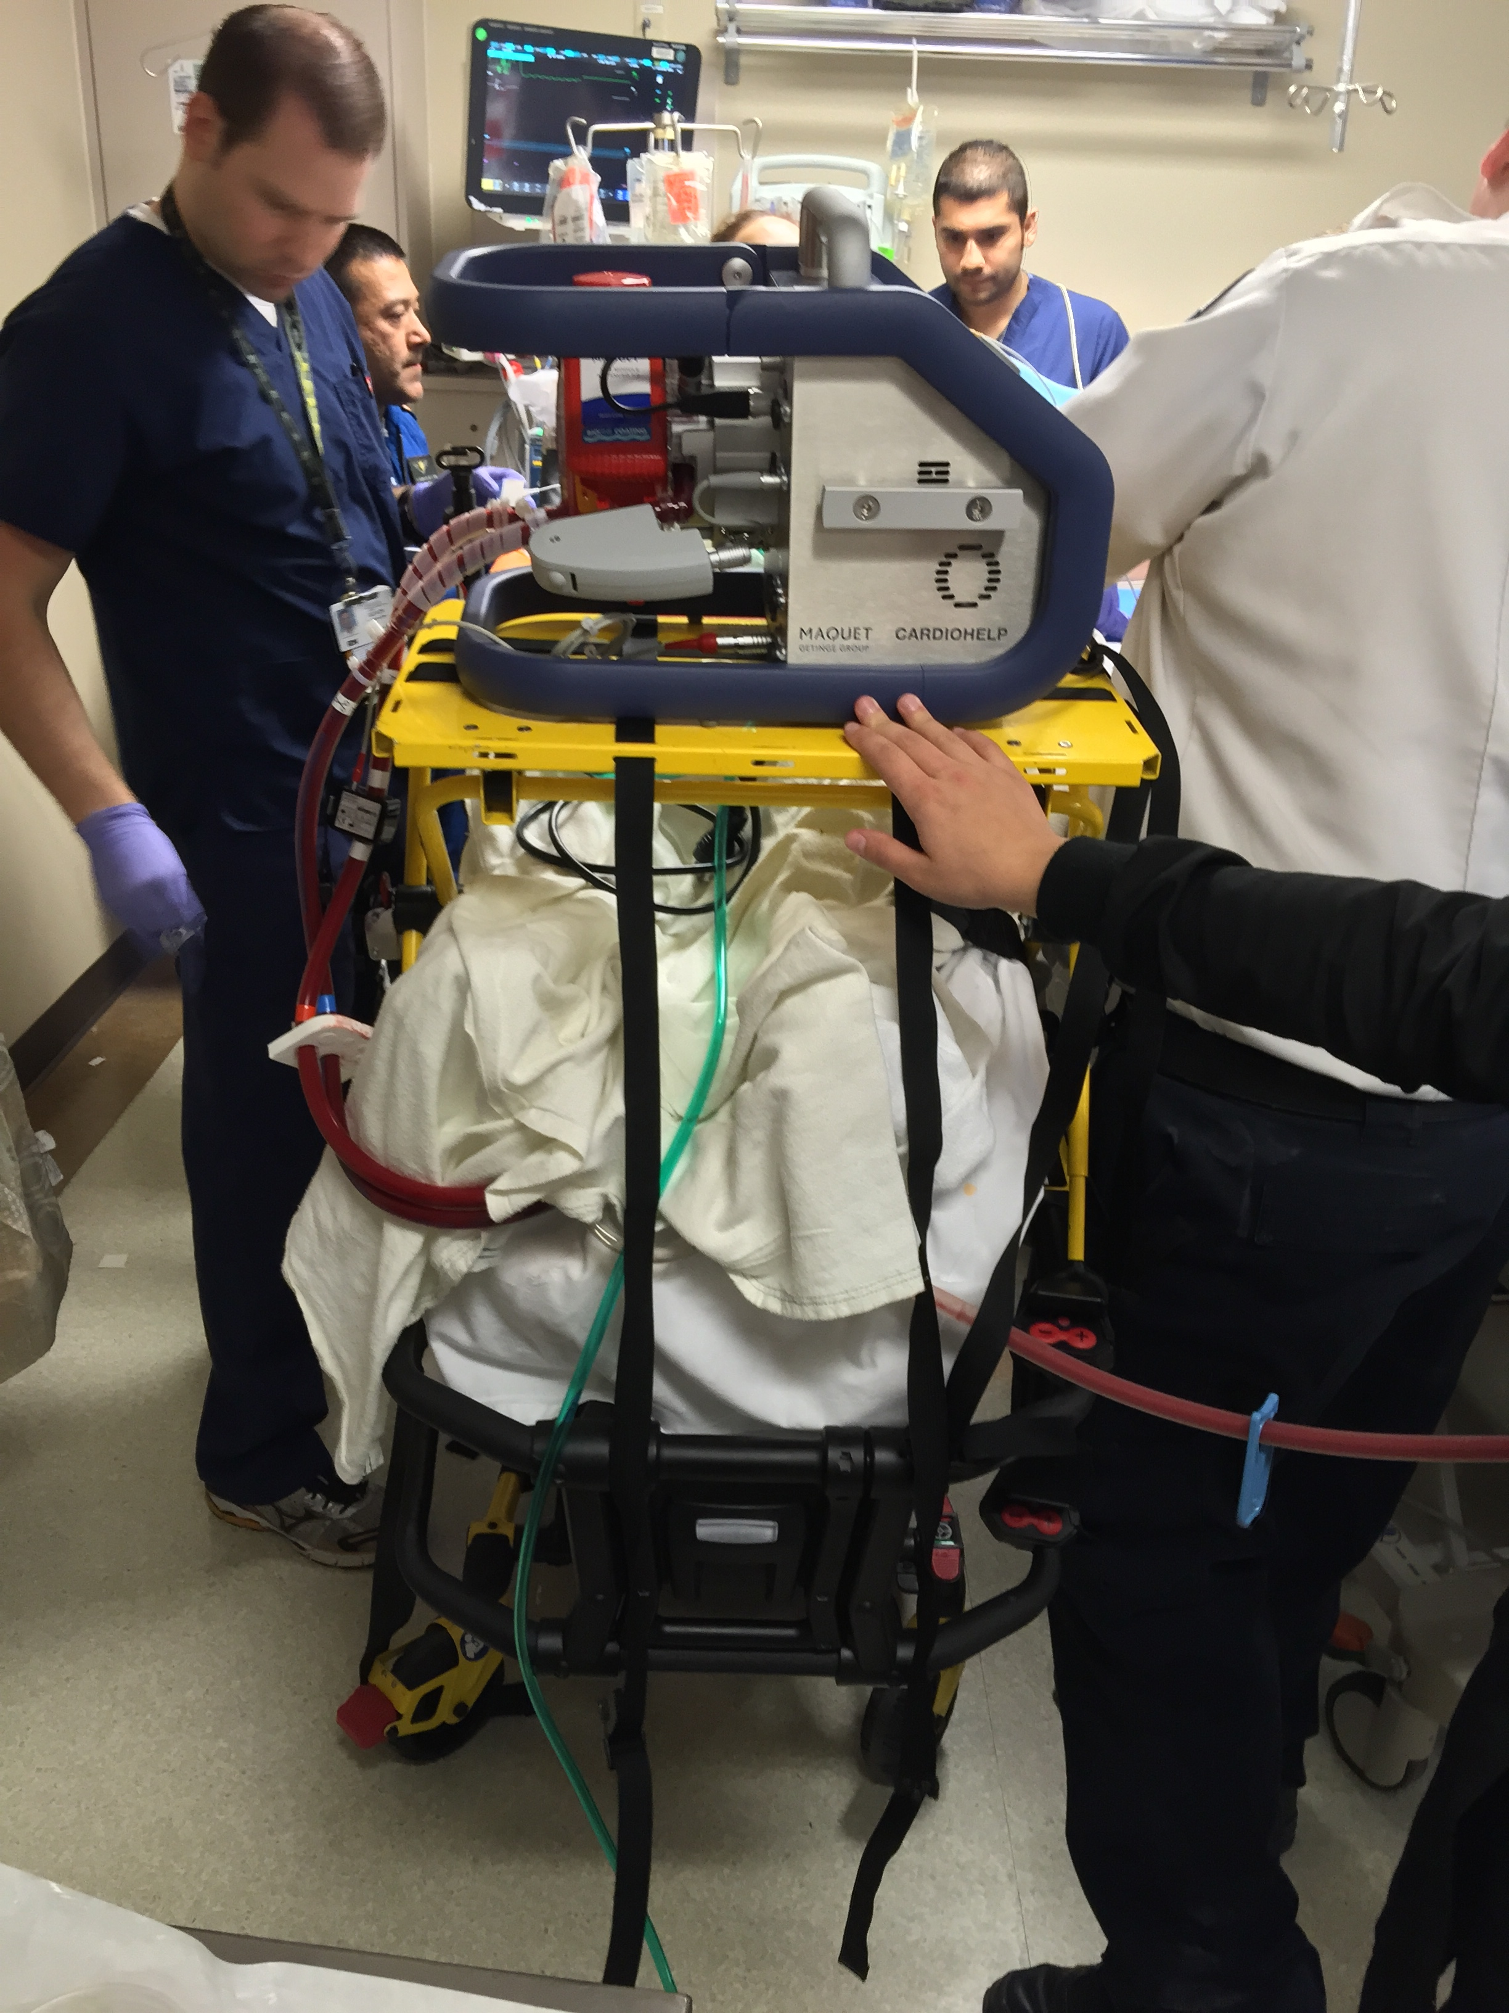
Cardiohelp Transport

Slide 18
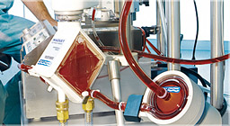
Rotoflow and Quadrox

Slide 19
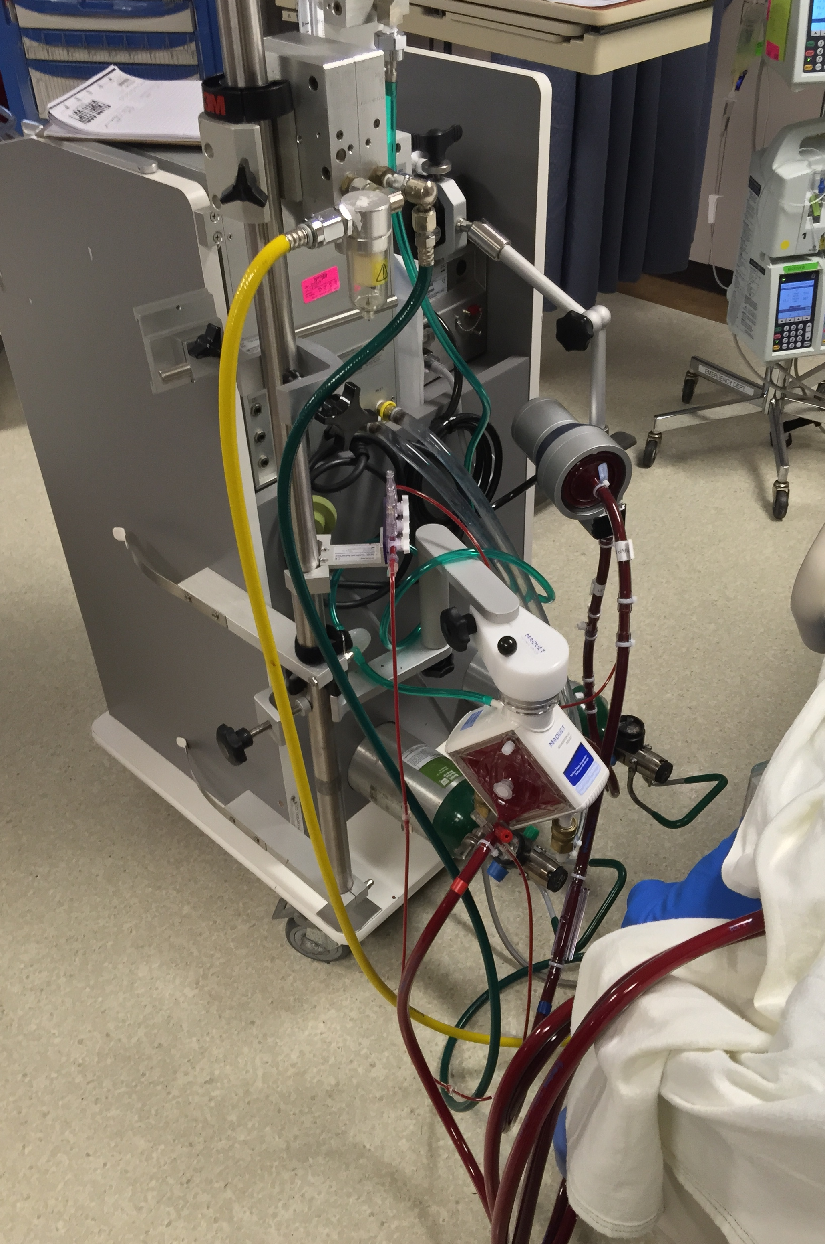
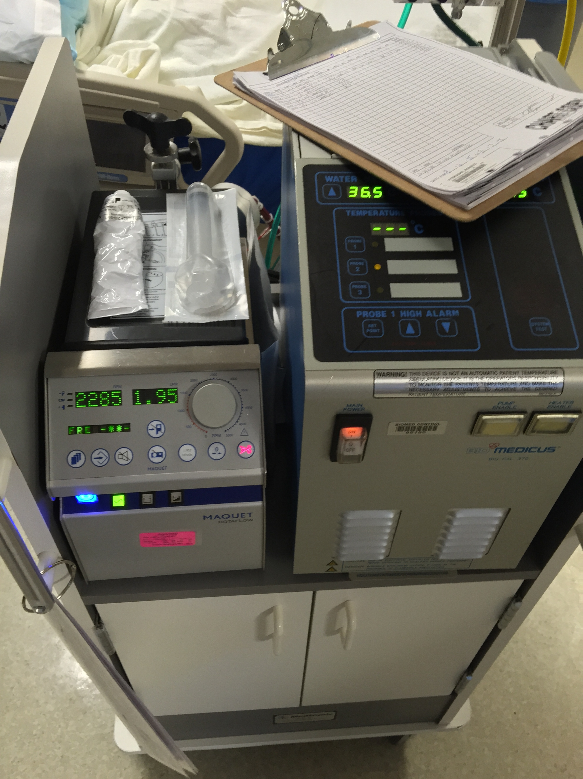
RotaFlow
Pump
Oxygenator
Notes:
The circuit consists of vascular access catheters, a pump, an oxygenator, a temperature control system, monitors, and access points

Slide 20
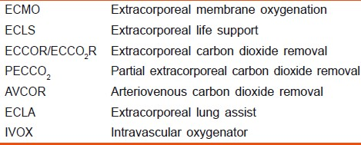
Take Your Choice
a general byword for the wide range of methods that are in use for extracorporeal blood oxygenation and carbon dioxide removal
Notes:
acronyms

Slide 21
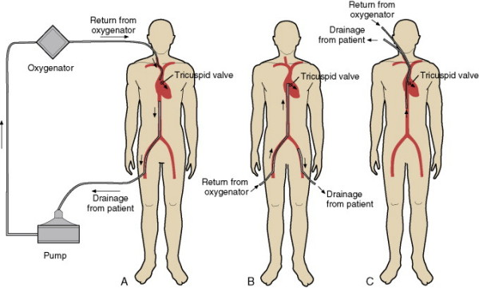


Slide 22
Indications VV
Hypoxic respiratory failure
  PaO2/FiO2 < 150 (FiO2 > 90%) Murray score 2-3
  Mortality Risk >50% should consider
  PaO2/FiO2 < 100 (FiO2 >90%) Murray score 3-4
  Mortality Risk >80% firm indication
CO2 retention despite high Pplat (>30)
Severe air leak
Need for intubation on lung transplant list
Immediate CV/pulm collapse (PE, Airway)
    ELSO Guidelines, Adult Repiratory Failure, December 2014
Notes:
Current data support its use after 10 min of adequate but unsuccessful Advanced Life Support

Slide 23
Contraindications VV
High vent settings 7 or > days
Significant immunosupression
CNS hemorrhage (recent or worsening)
Increased risk with increased age
Non recoverable comorbidity

Slide 24
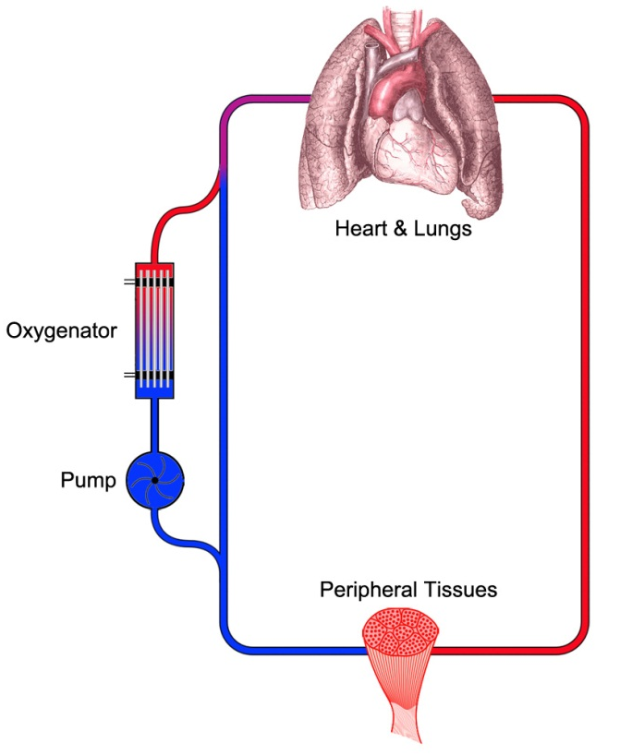
VV ECMO AIMS
Right sided blood preoxygenated so lung function is not required
Converts right sided venous blood into “arterial” blood
Allow the lung to “rest”
Does not support cardiac function directly
Notes:
Extremely efficient at ventilation, less so with oxygenation
At high flow rates (>70% of normal CO), acceptable oxygenation and CO2 clearance can be achieved without any pulmonary gas exchange
Used for isolated lung support

Slide 25
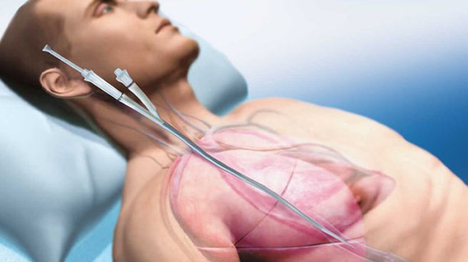
Venovenous Bypass
Usually from femoral vein (drainage) to femoral vein or IJ (infusion) or IJ alone (dual lumen catheter)
Notes:
separate the cannulae (typically by >2 cm)
Dual lumen AVALON

Slide 26
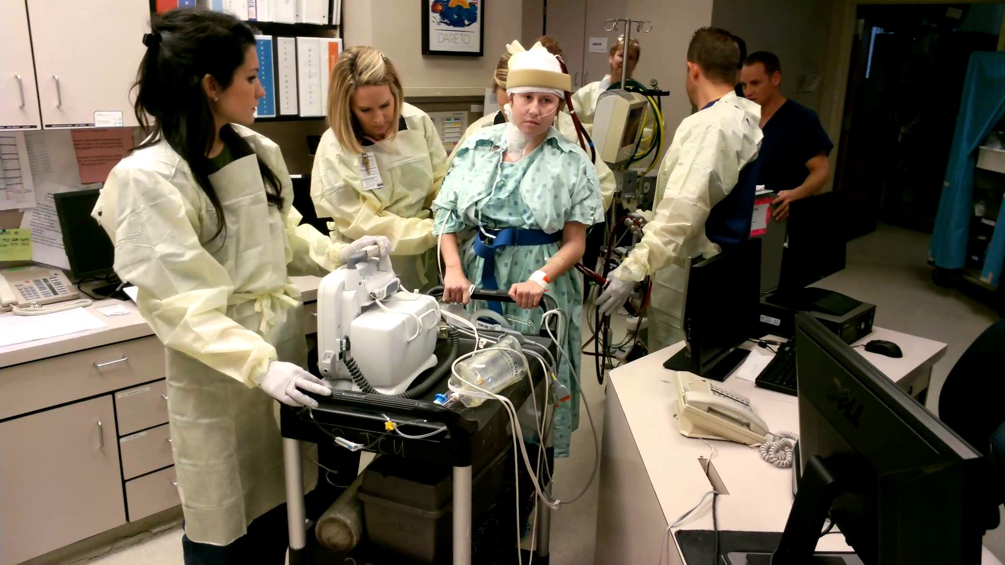
Carrie Walking on ECMO YouTube

Slide 27
Venoarterial Bypass
Takes deoxygenated blood returns it to arterial system centrally
  Access points
    (centrally from right atrium to aorta or peripheral from IJ or femoral vein to femoral artery)
Supports cardiac output
Delivers higher levels of oxygenated blood to the tissue
Higher risk of systemic emboli

Slide 28
Indications VA ECMO
Cardiogenic shock
  Hypotension and low cardiac output despite resuscitation
  Resistent to inotropes and IABP potentially
  Septic shock +/-
Recovery post-op
“Bridge” to transplant, LVAD, revascularization

Slide 29
Containdications VA ECMO
Unrecoverable heart and no transplant
Advanced age
Organ disfunction (chronic)
Prolonged CPR without adequate perfusion
Containdication to anticoagulation
  (relative)

Slide 30
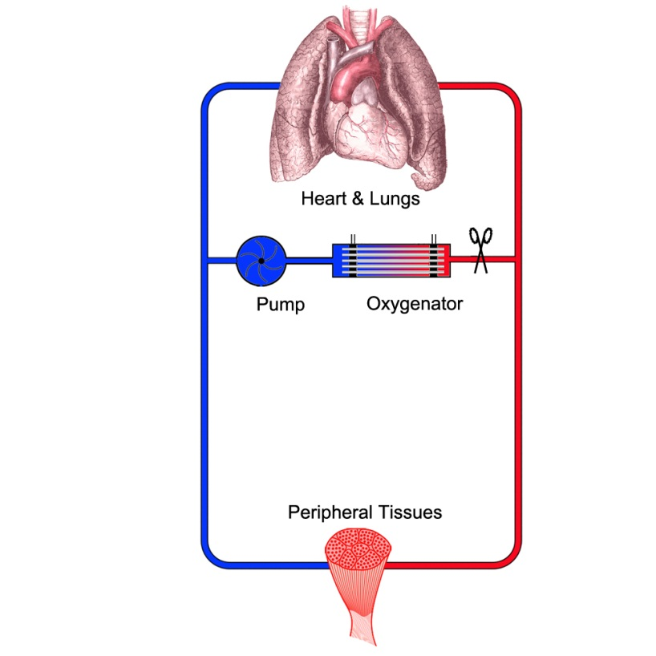
VA ECMO Aims
Replace the cardiac output with forward flow of arterial blood
Circulatory Support
Less pulmonary “support” but some

Slide 31
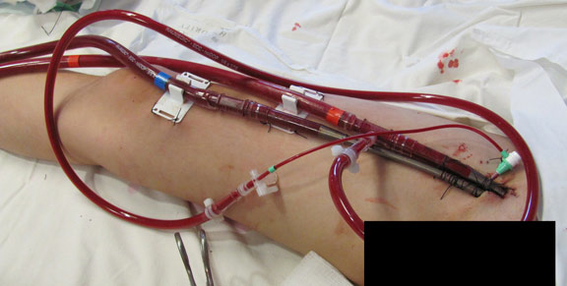
V-A ECMO Catheters

Slide 32
Anticoagulation
Necessary for V-A secondary to risk of embolic complications
Preferred in V-V but can be done without if necessary
  Increase risk of DVT/PE and oxygenator loss
Heparin preferred
ACT 1.5 normal

Slide 33
Transfusions
Thrombocytopenia is common and regular platelet transfusions may be necessary
Transfusion requirements for most patients are along the lines as transfusion requirements for any other patient but may be higher 2/2 blood loss from access points, hemolysis, etc.

Slide 34
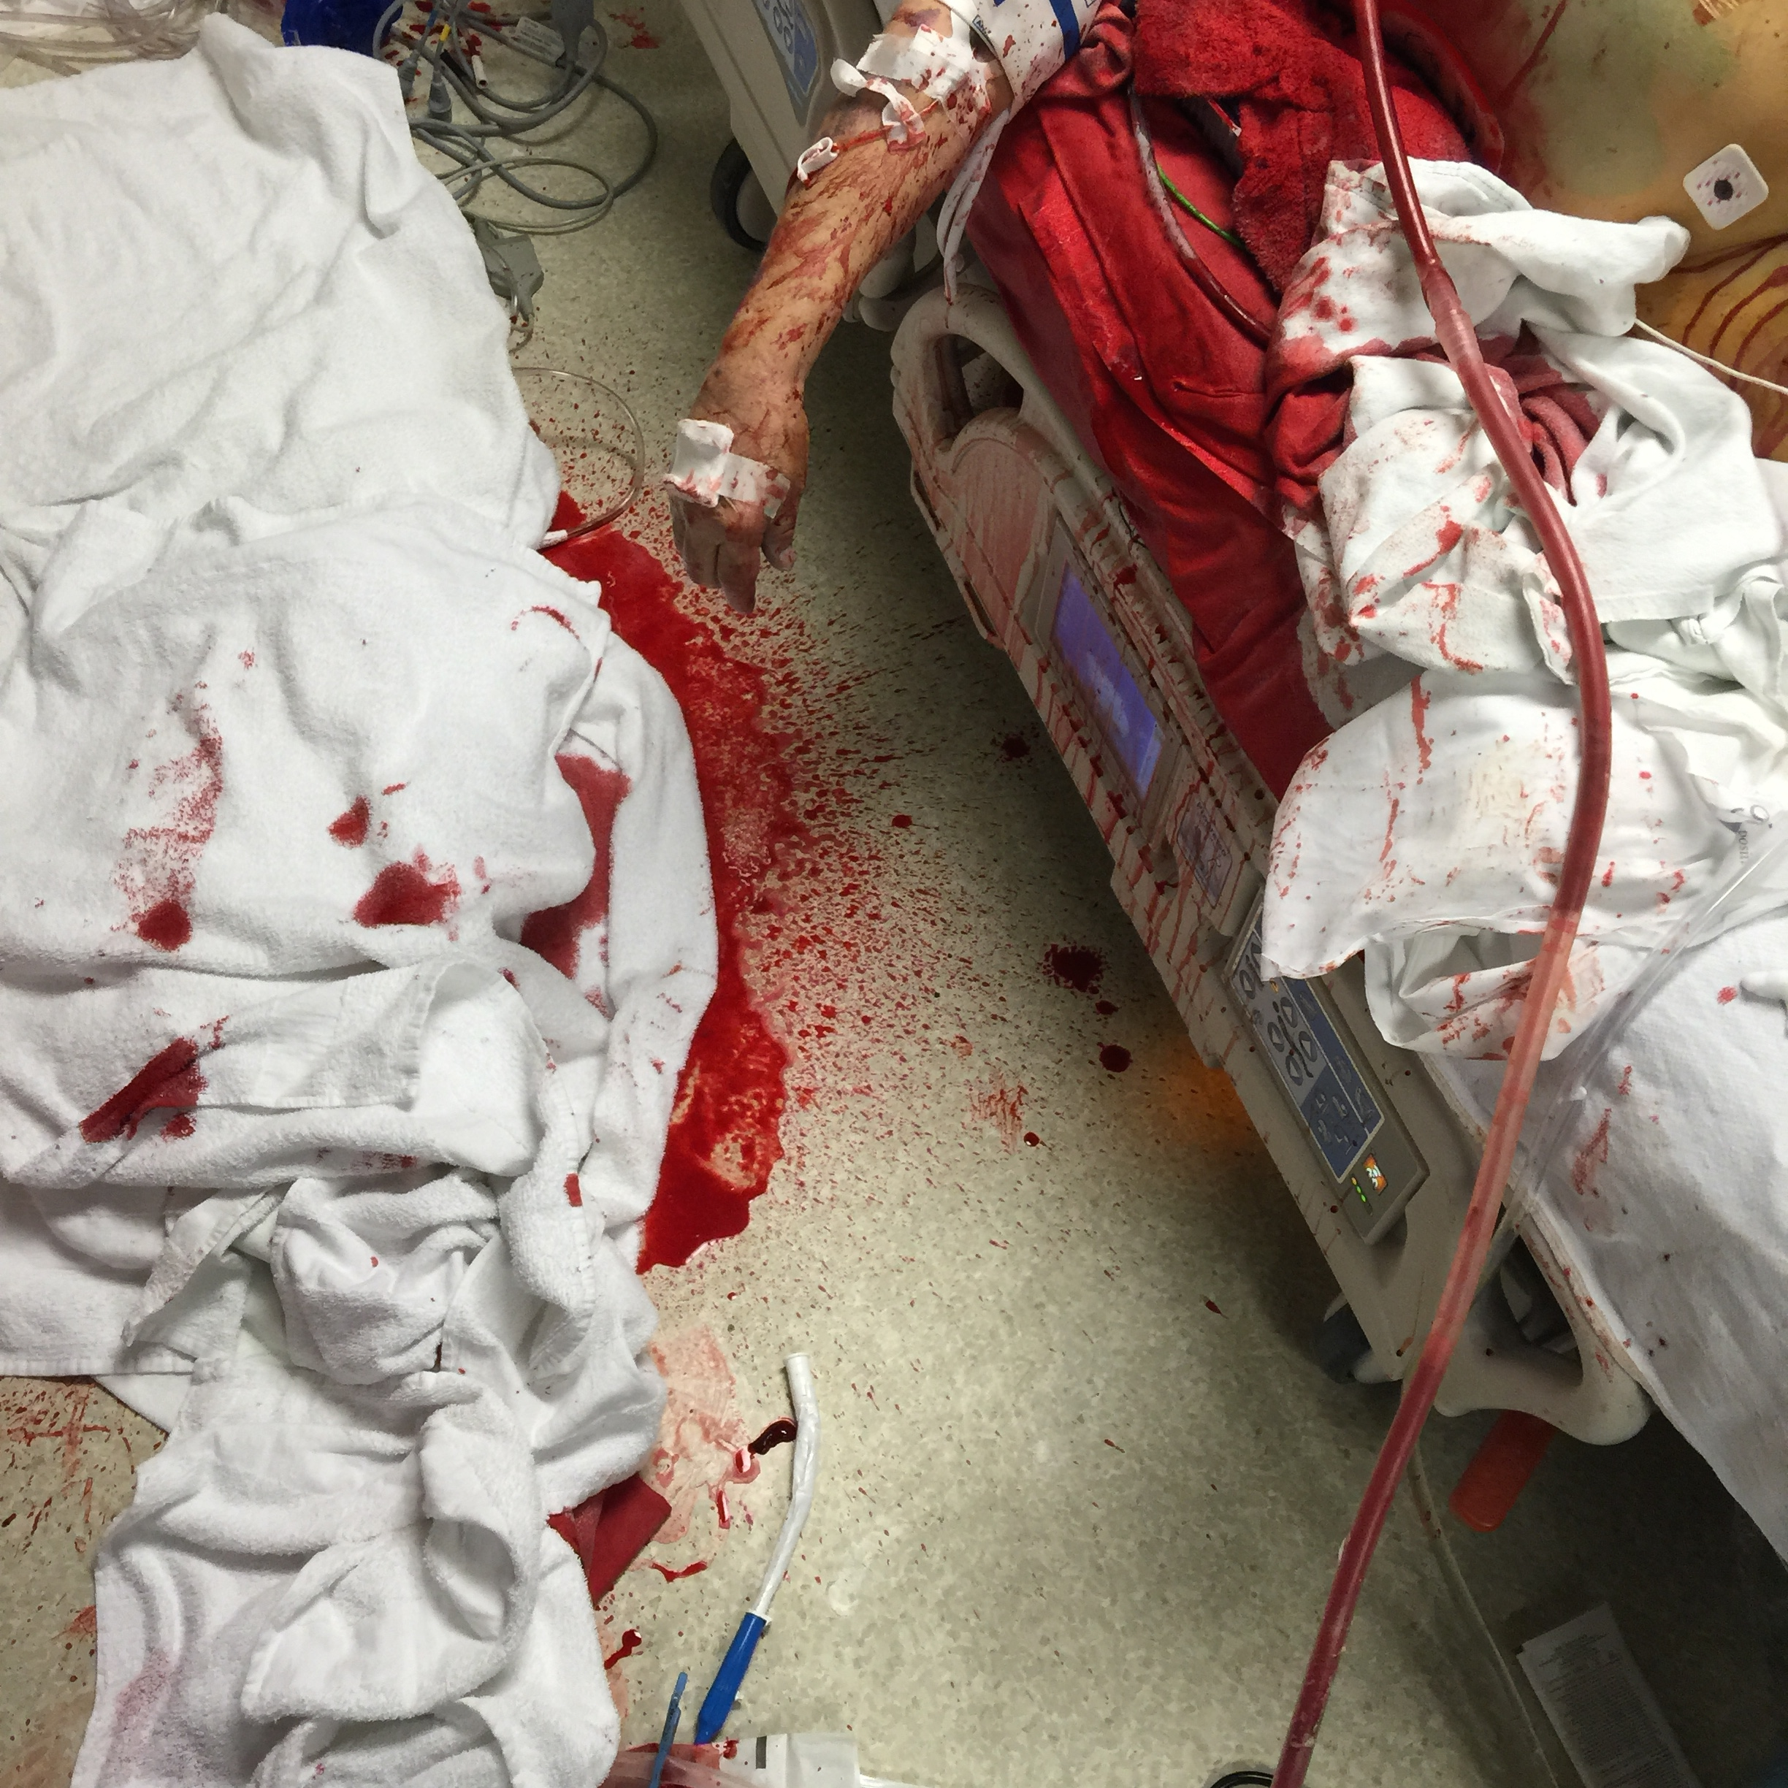

Slide 35
Things to monitor
Blood Flow rate (Liters per min)
Sweep rate (Liters per min).
Negative Venous Drainage Pressures
Pre and Post Oxygenator Pressures
ACT or PTT
Circuit condition – any clots / fibrin strands?
Notes:
Little black spots on the periphery of the oxygenator

Slide 36
Management
Blood flow rate- determines oxygen delivery
  VV ECMO- want high flow rates to optimize oxygen delivery. (~120% of VA flow)
  VA ECMO- want high enough for adequate perfusion pressure and venous SvO2, but low enough to provide sufficient preload to maintain left ventricular output.
Sweep gas flow rate- determines the concentration of CO₂ extracted
Notes:
100% oxygen

Slide 37
Complications
  Cannulation-
    Pneumothorax, bleeding, infection, emboli, vascular disruption
Systemic anticoagulation-
  >50% suffer a hemorrhagic complication- most serious ICH
Distal interruption of arterial flow
  Distal perfusion catheter
North-South syndrome

Slide 38
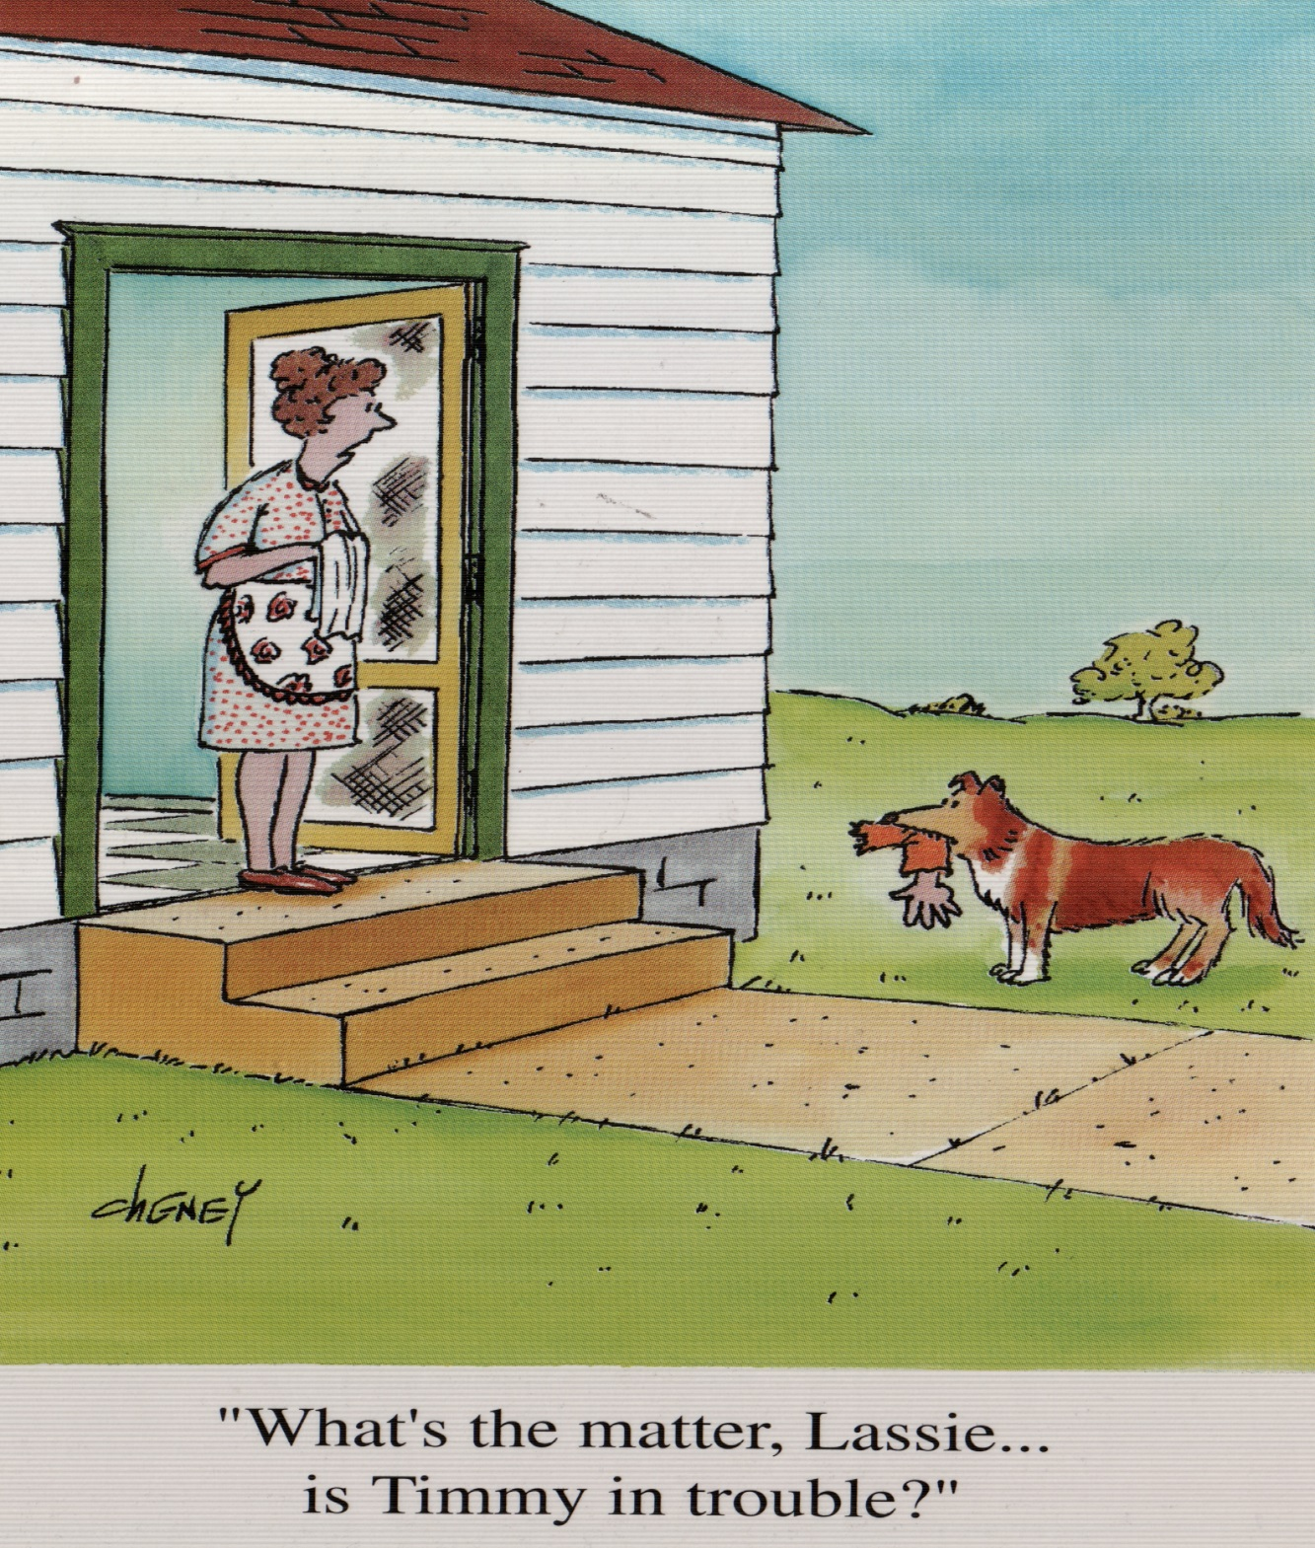

Slide 39
CESAR trial
180 patients with potentially reversible severe acute respiratory failure were randomized to conventional management or ECMO
Survival at 6 months was significantly greater in patients allocated for consideration of ECMO (63% vs 47%)
ECMO resulted in one additional survivor for every 6 treated

Slide 40
Influenza
ANZ-ECMO Influenza Investigators-201 patients in ICUs with confirmed or suspected 2009 influenza A (H1N1) infection
  68 patients received ECMO after failing to improve on conventional treatment
  P:F ratio of 56, PEEP 18 cm H2O, and peak airway pressure 36 cm H2O.
  The median time on ventilator before initiating ECMO was 2 days
  Median duration of ECMO support was 10 days.
  Final survival to hospital discharge 75%
237 adult respiratory failure patients with novel H1N1 influenza treated with ECLS, with 159 surviving (67%).

Slide 41
J Trauma Acute Care Surg. 2014 May;76(5):1275-81. doi: 10.1097/TA.0000000000000213.
Venovenous extracorporeal life support improves survival in adult trauma patients with acute hypoxemic respiratory failure: a multicenter retrospective cohort study.
Guirand DM1, Okoye OT, Schmidt BS, Mansfield NJ, Aden JK, Martin RS, Cestero RF, Hines MH, Pranikoff T, Inaba K, Cannon JW.
102 adults with severe hypoxemic respiratory failure with PaO₂/FiO₂ ≤80.
26 ECMO vs 76 coventional management
  58% survival with ECMO (mean p/F < 50)
“VV ECLS is independently associated with survival in adult trauma patients with AHRF. ECLS should be considered … when conventional therapies prove ineffective; (and) if not readily available, transfer to an ECLS center should be pursued.”

Slide 42
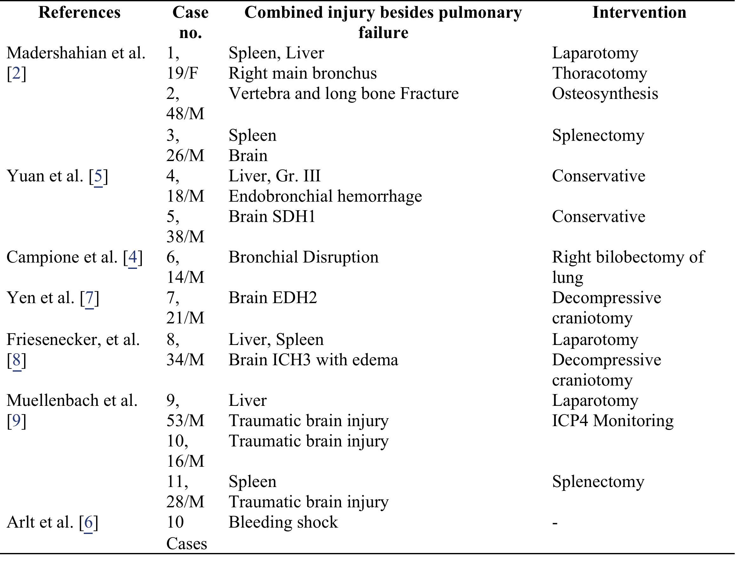
World J Emerg Surg. 2015; 10: 15. doi:10.1186/s13017-015-0006-9
Published online 2015 Mar 12.

Slide 43
ECLS registry ELSO.org
January 2015
Adults Total # Survival percent
Respiratory 7008 4587 65
Cardiac 5603 3129 56
ECPR 1657 639 39

Slide 44
Who’s gonna pay for it?
Cost- $20,000-90,000 per patient
Hospital costs for a new therapy patient ($120,800) exceeded those for a control therapy, patient ($97,200) by $23,600
Recent estimates of ARDS incidence suggest that 12,500 ARDS per year could be expected in the United States (67). If treated with ECMO, would produce a cost increase of $295,000,000 per year

Slide 45


Slide 46
32 y/o with complicated GSW chest
RLL lung abscess and empyema
  OR for decortication and wedge resection
  “uneventful” 2 days till another smaller abscess eroded into pulmonary artery
  Coded with massive hemoptysis
    Unable to oxygenate or ventilate
  Emergent VA ecmo and RLL lobectomy
  30 hr ECMO, extubated day 2
  Home POD 9

Slide 47
Big “Mo”
46 y/o small caliber GSW right chest after being robbed
  Second GSW
GCS 15
  wants to leave to close his shop
  Pulse 100, 140/90, R 15
  FAST negative
Bullet midline ?superficial
  Cant see on lateral secondary to size
  CT performed

Slide 48
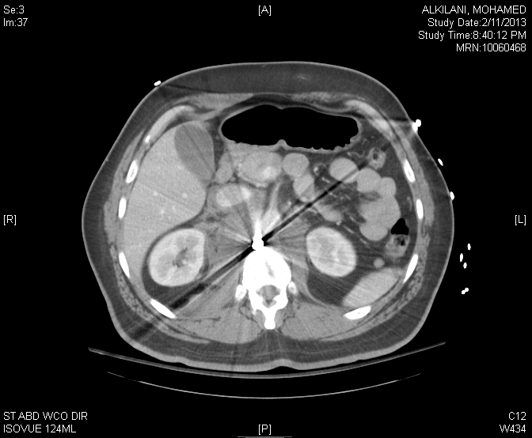

Slide 49
Big “Mo” OR
Posterior through and through aorta medial to celiac trunk and out posteriorly
Initially OK. Extubated POD 4
Reintubated POD 6 worsening hypoxia
Acinetobacter pneumonia
  Multidrug resistant
Trache, APRV, HFOV failed
  7.16/60/82 on 100% POD 12

Slide 50
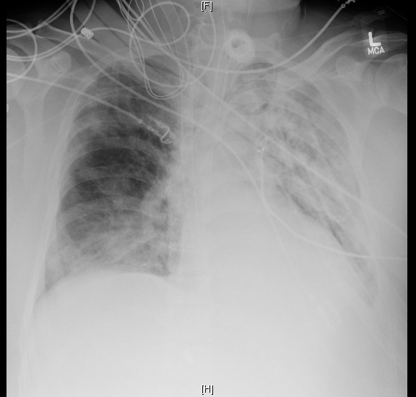

Slide 51
Big “Mo” on ECMO
V-V ECMO POD 16
  Complicated ICU stay
    GIB
    AKI requiring CRRT
    Encephalopathy
    Ileus
    Wound infection
    CAUTI
    HAPU

Slide 52
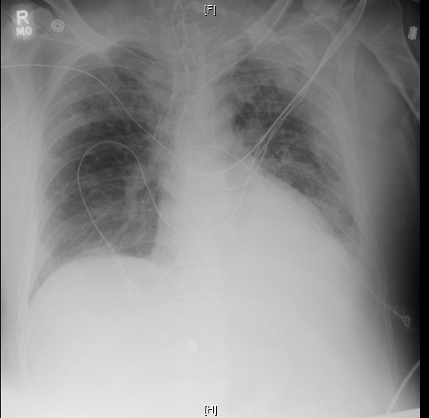

Slide 53
Big “Mo” on ECMO
17 day VV ECMO run
28 days on vent (plus initial 4 days)
36 ICU days
56 hospital days
Transfer to rehab
Called for office visit 4 months following rehab with severe right groin pain

Slide 54
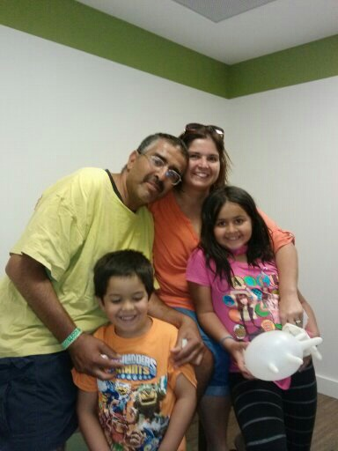

Slide 55
KK
26 year old male s/p MCC on 10/16/2014
Right LL laceration
Multiple rib fractures with right flail chest
Transverse colon deserosalization
Right retroperitoneal hematoma
Duodenal Injury
Grade 3 Liver Laceration
L4 Burst Fracture
SAH
Multiple SP/TP fractures

Slide 56
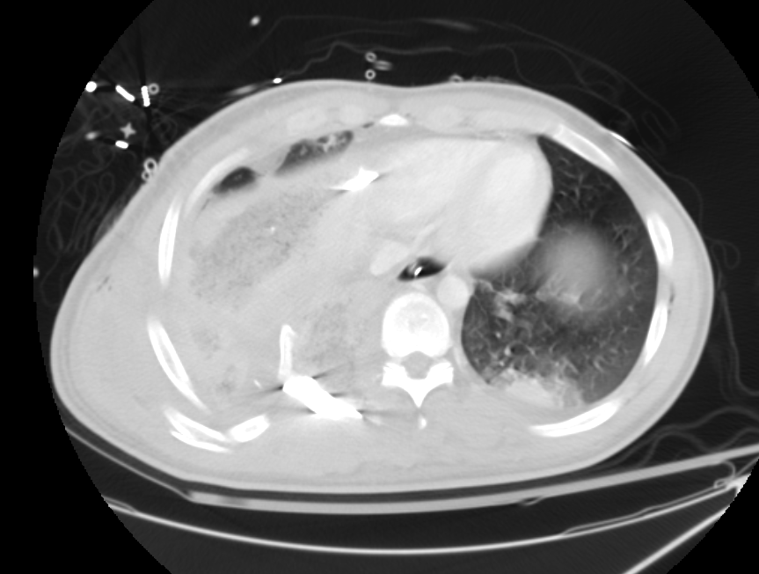
KK

Slide 57
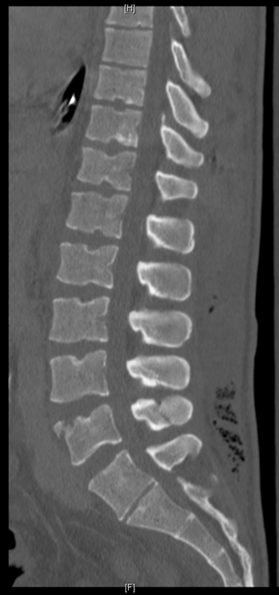
KK
Thoracotomy with RLL wedge resection
Exploratory laparotomy with retroperitoneal exploration with intra-abdominal packing
IR embolization
Re-exploration with repair of duodenum/colon
Right rib plating
Severe ARDS

Slide 58
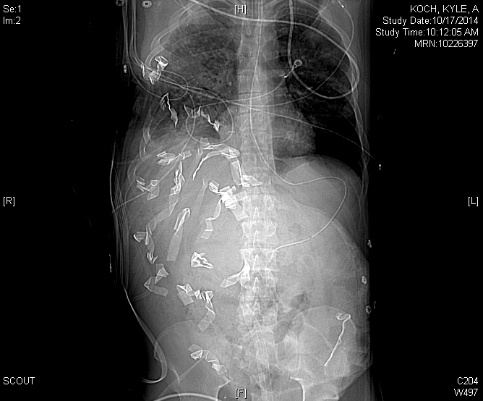

Slide 59
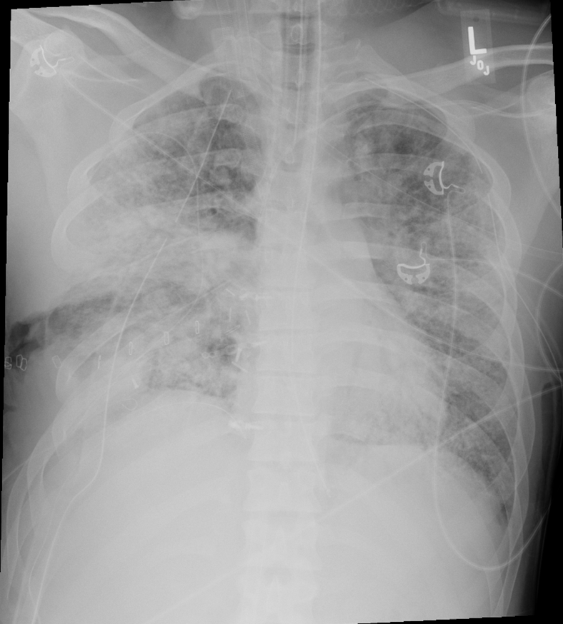
KK
10/25: CTS at BUMC consulted for ECMO
  RIJ/Right Femoral V-V Cannulation
  Transferred to BUMC
10/26: Reopening laparotomy with washout/closure

Slide 60
KK
11/3: Reopening thoracotomy for bleeding/removal of hardware; CVVHD started
11/5: Reopening thoracotomy/washout/debridement/closure, EGD
11/19: Percutaneous Tracheostomy
11/22: Decannulation

Slide 61
KK
Adrenal Insufficiency requiring corticosteriods
CVVHD
Hypotension requiring pressors/resuscitation
Dysphagia/malnutrition managed with dobhoff
Infection: bronchoscopy with enterococcus, chest fluid with enterococcus/enterobacter, JP with VRE
Left lung PTX requiring chest tube
Right chest tube with air leak
T4 Burst Fracture: Non-operative with corset

Slide 62
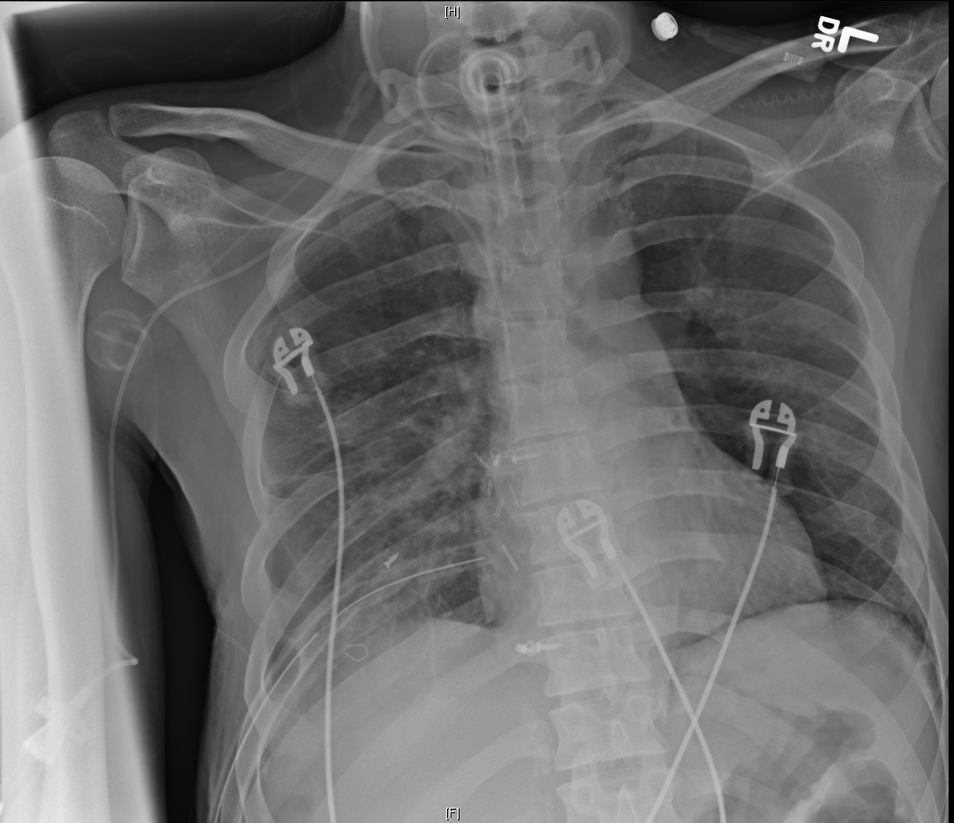
KK
12/12: Transferred to BIR
12/13: Transferred to BUMC for evaluation of seizure
  Possible h/o seizures prior to MVC
  Continue purulent right chest tube drainage

Slide 63
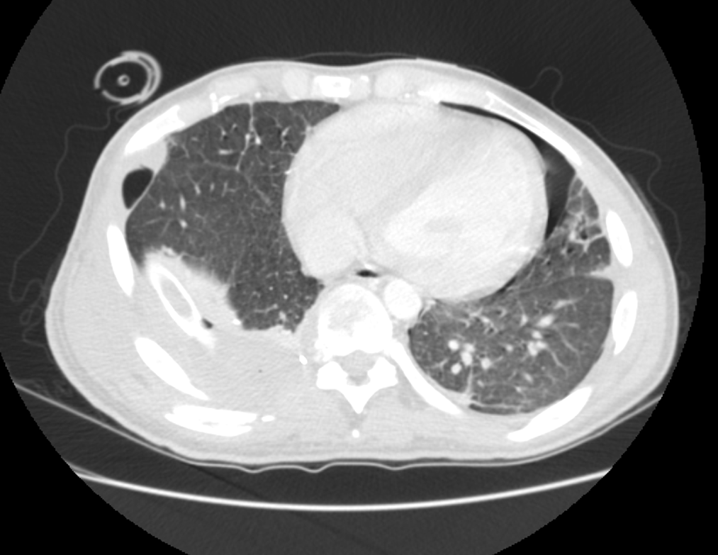
KK

Slide 64
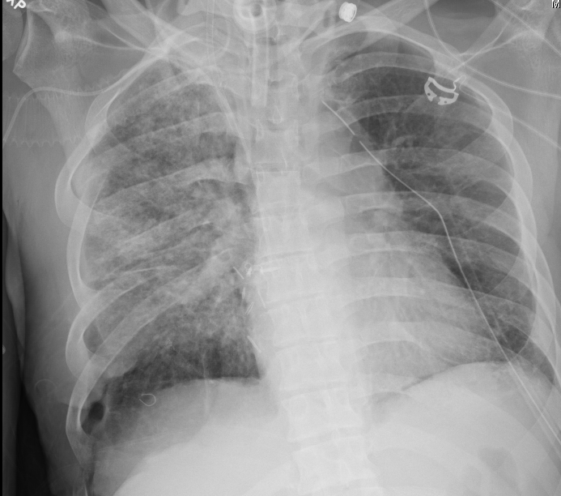
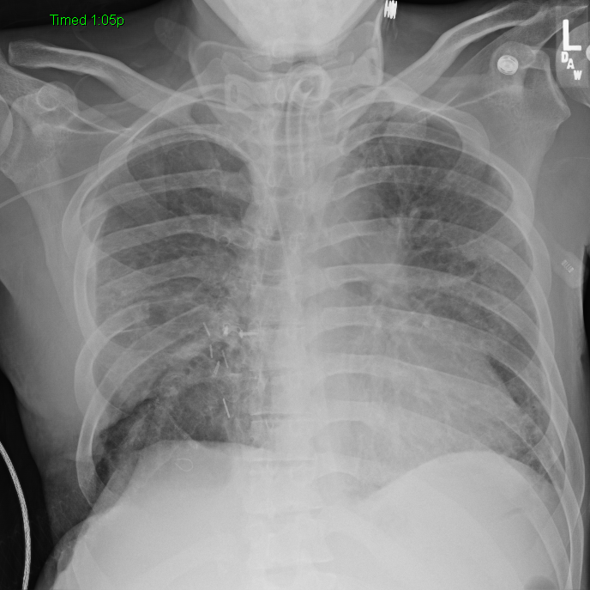
KK
12/18: Left thoracostomy for pneumothorax/Right thoracotomy with Clagett Window

Slide 65
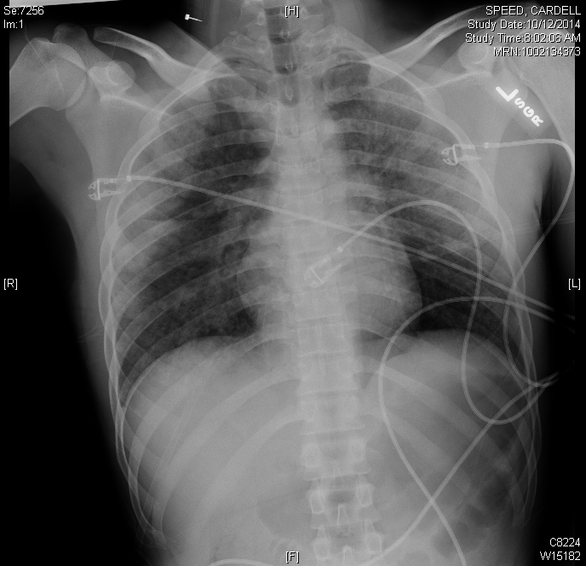
Notes:
Mvc ejection gcs10 obvious resp difficulty and hypoxia. Bilateral open femur fx, small sah, acetabular fracture.
ABG on arrival 7.14/ 80/ 23/Base excess -16
Ground glass appearance on cxr

Slide 66
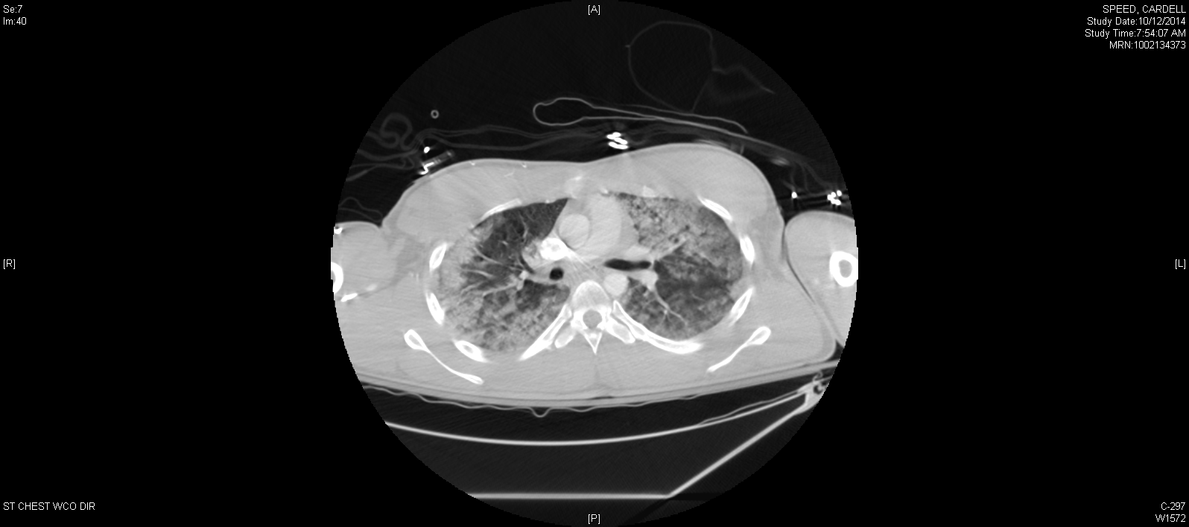

Slide 67
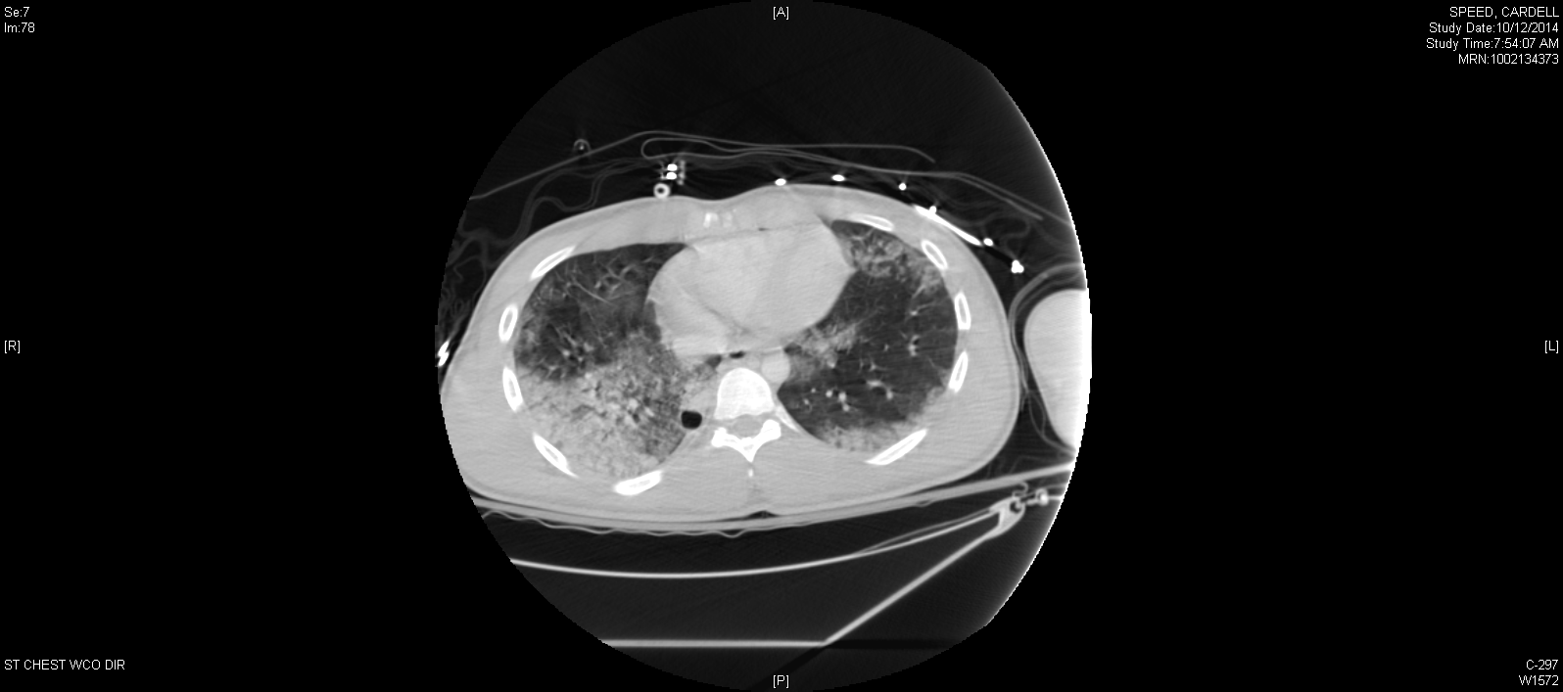

Slide 68
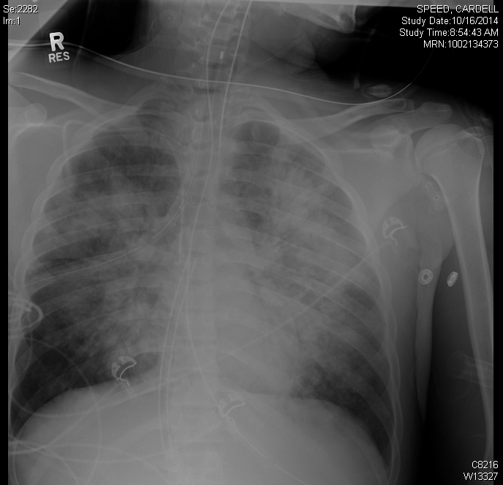
Notes:
Oxygenation worsened moved to HFOV almos immediately could not oxygenate moved to VV ecmo. Arrested and went to VA ecmo

Slide 69
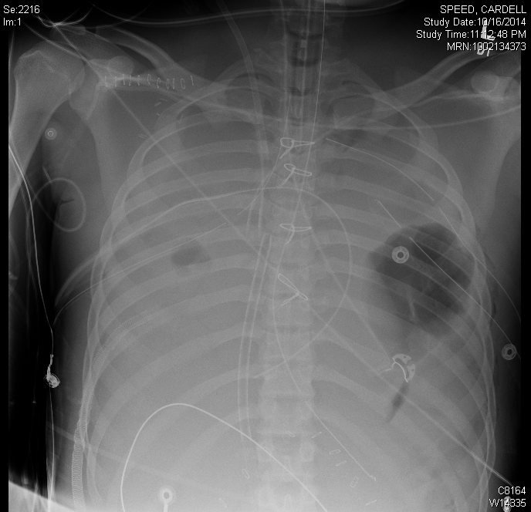
Notes:
3 days later
Went on to expire

Slide 70
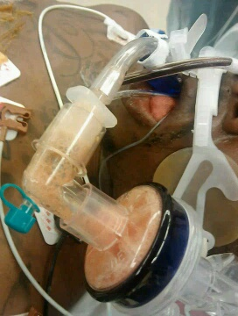
Back to our original patient
Notes:
In or multiple arrests from hypoxia, pulm edema from left heart failure and volume

Slide 71
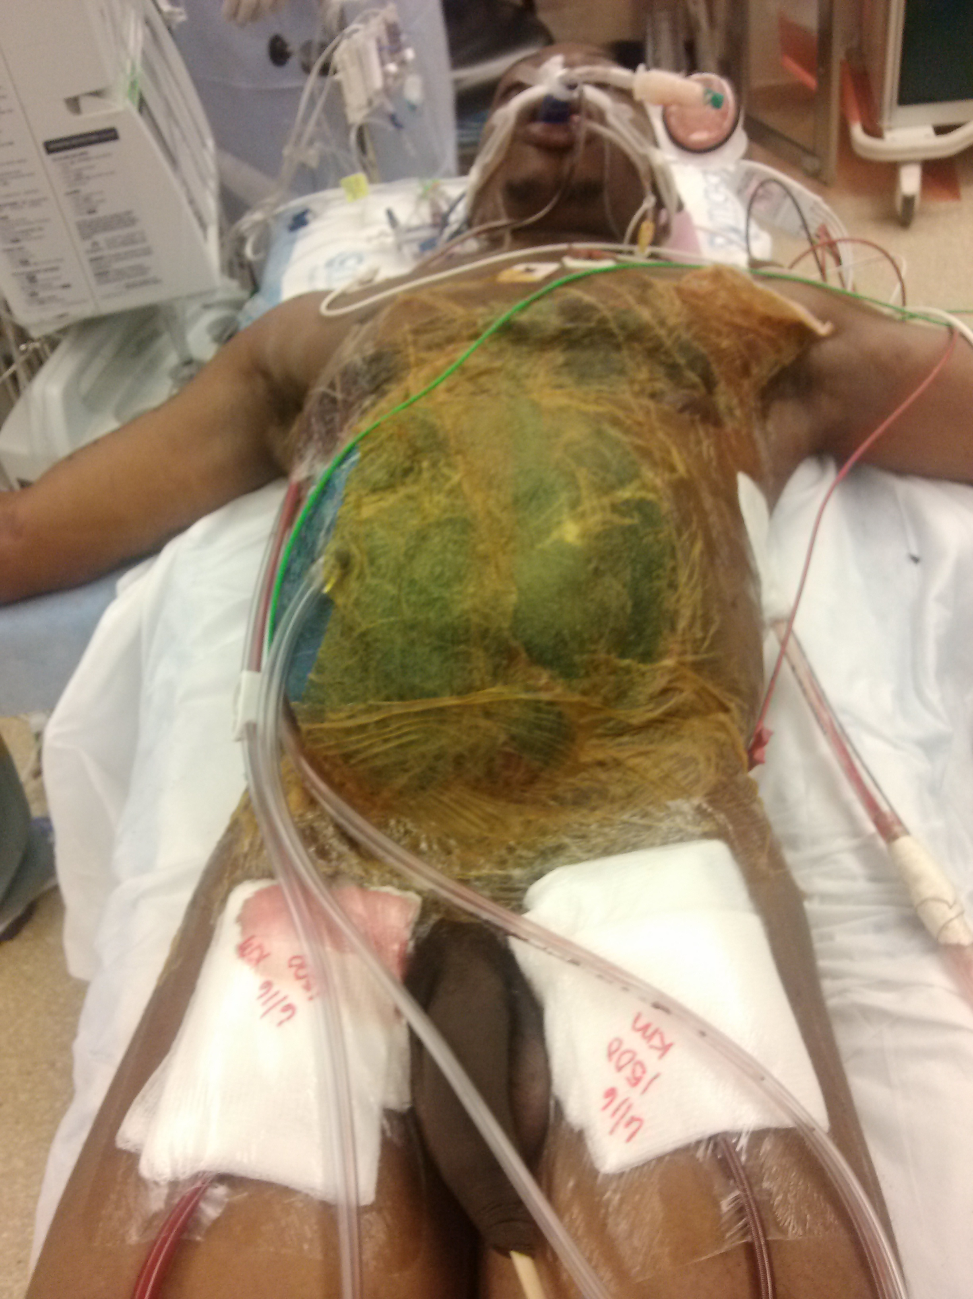
Notes:
Inserted ecmo and he survived but unfortunately vegitative

Slide 72
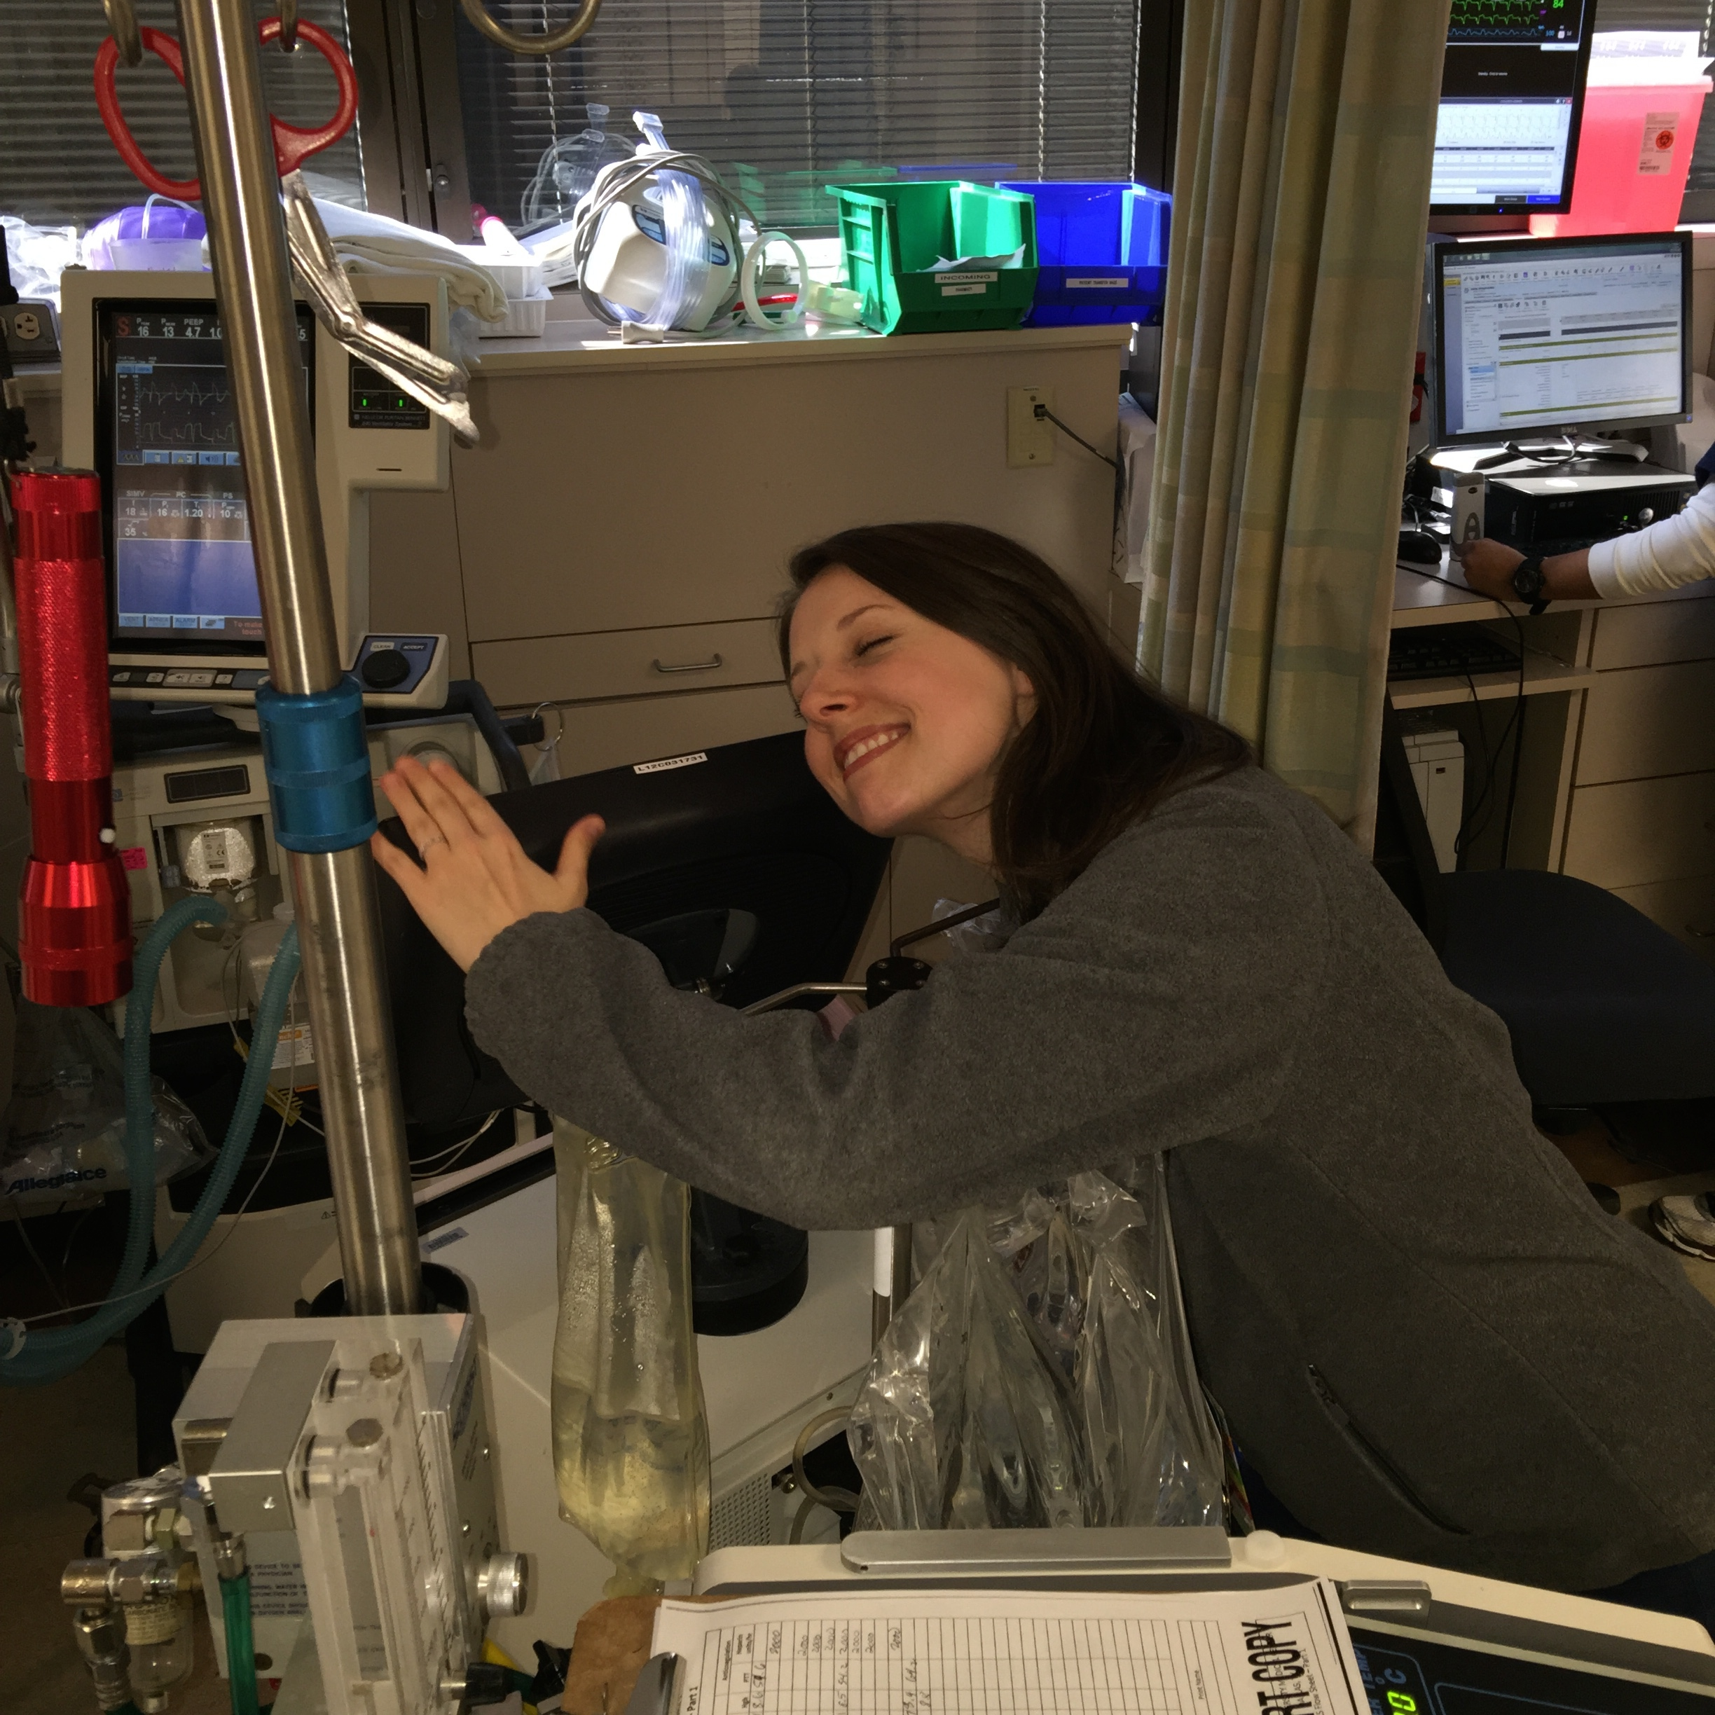
Notes:
Our nurses love it

Slide 73
ECMO in Trauma
Here to stay
Absolutely appropriate for lung support
Probably has a place in resucitation
Expensive
Time consuming
Complicated
Definitely a team sport

Slide 74
