Slide 1
Knowledge Influences Professional Attitudes:
When to Make the Call
Cynthia V. Catchings, LCSW ~ CLYL
Executive Director
Family Crisis Center
of the Rio Grande Valley

Slide 2
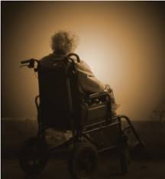


From the experience of an
APS Supervisor~Domestic Violence Center’s Executive Director

Slide 3
Knowledge Influences Professional Attitudes:
When to Make the Call
Adult Protective Services
Child Protective Services
Domestic Violence
Scenarios and Q&A Session

Slide 4
PROTECT THE UNPROTECTED
OBJECTIVES
Know the difference between Adult Protective Services and Child Protective Services, who and how they serve, and when to make the call.
Obtain tangible resources to better serve child and elderly clients through the APS kit and CPS Trauma Informed Care Training.
Define domestic violence, know regional statistics, and know when and where to report or refer for help.
Know and understand the domestic violence and child/adult abuse overlap issues.

Slide 5
Adult Protective Services
What is APS?
APS is an agency under the TDFPS that investigates A/N/E of adults who are elderly or have disabilities.
Who gives authority to APS to Investigate and Act?
Chapter 48, Title 2 of the Human Resource Code (HRC), authorizes the agency to "investigate the abuse, neglect, and exploitation of an elderly or disabled person and to provide protective services to that person."
What is A/N/E?

Slide 6
Adult Protective Services
Types of Maltreatment
Abuse means the "negligent or willful infliction of injury, unreasonable confinement, intimidation, or cruel punishment with resulting physical or emotional harm or pain by a caretaker, family member, or other individual who has an ongoing relationship with the person."
Abuse includes…
Source: Texas Human Resource Code Ch. 48

Slide 7
Adult Protective Services
Types of Maltreatment
Neglect means "the failure to provide for one's self the goods or services, including medical services, which are necessary to avoid physical or emotional harm or pain or the failure of a caretaker to provide such goods or services." Neglect may result in ...
Source: Texas Human Resource Code Ch. 48

Slide 8
Adult Protective Services
Types of Maltreatment
Exploitation means "the illegal or improper act or process of a caretaker, family member, or other individual who has an ongoing relationship with the elderly or disabled person, using the resources of an elderly or disabled person for monetary or personal benefit, profit, or gain without the informed consent of the elderly or disabled person."
This includes …
Source: Texas Human Resource Code Ch. 48

Slide 9
Adult Protective Services
In-Home Investigations and Services
In-home caseworkers investigate allegations of ANE of vulnerable adults in their or their relatives’ homes.
Facility Investigations and Services
APS facility staff investigate ANE of clients receiving services in state operated and/or contracted settings that serve adults and children with mental illness or mental retardation.

Slide 10
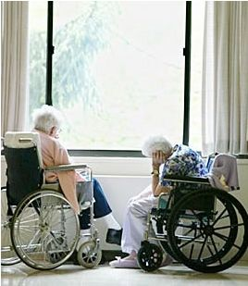
Adult Protective Services
How about Nursing Homes?
The Texas Department of Aging and Disability Services (DADS) investigates reports in nursing homes.

Slide 11
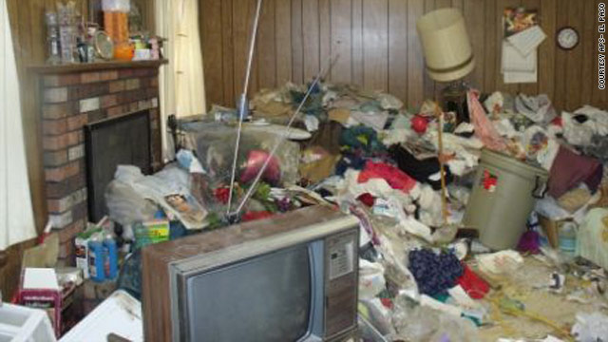
Adult Protective Services
APS in-home staff refer cases that require guardianship services to the Department of Aging and Disability Services. Guardianship is a legal method to protect individuals' well being when they are legally incapacitated and cannot protect themselves.

Slide 12
Adult Protective Services
How APS Works
Someone suspects
A call is made to the DFPS Abuse Hotline at 1-800-252-5400 to report the alleged maltreatment.
A priority is assigned to the report P1, P2, P3, P4
Statewide Intake staff send the report to local APS staff for investigation.
APS Specialists contact all people who might know about the alleged maltreatment.
Specialist evaluates the information gathered…
If validated, case will be put into the service stage

Slide 13
Adult Protective Services
Nearly one out of five people have a disability, and almost one-half of people over 65 have a disability.
Texas has more than 2.5 million residents age 65 or older
In Fiscal Year 2012, APS completed 87,487 investigations of ANE involving adults living at home. Of these, more than 59,595 were validated.
In Fiscal Year 2012, Adult Protective Services completed 10,803 mental health and intellectual disability (MH&ID) investigations, which include settings such as state hospitals, schools, and centers.
In the last decade, the number of in-home cases investigated by APS has increased by 35%.
More than 90% of the allegations of maltreatment that are validated in APS in-home cases include neglect.

Slide 14
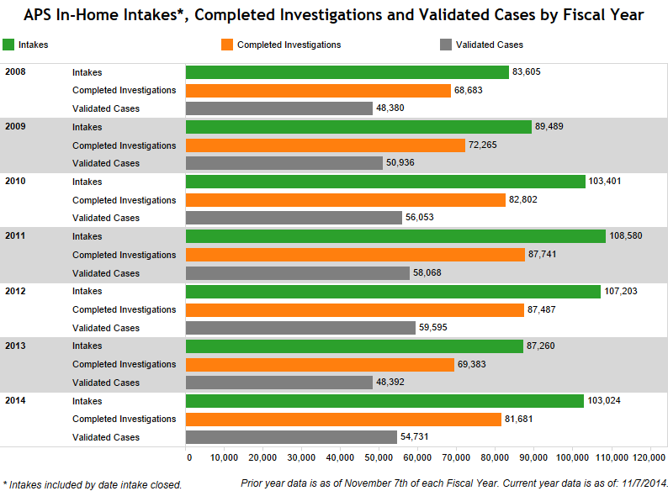
APS Statistics in the RGV

Slide 15
Adult Protective Services
Making a report by phone:
1-800-252-5400
Online:
https://www.txabusehotline.org

Slide 16
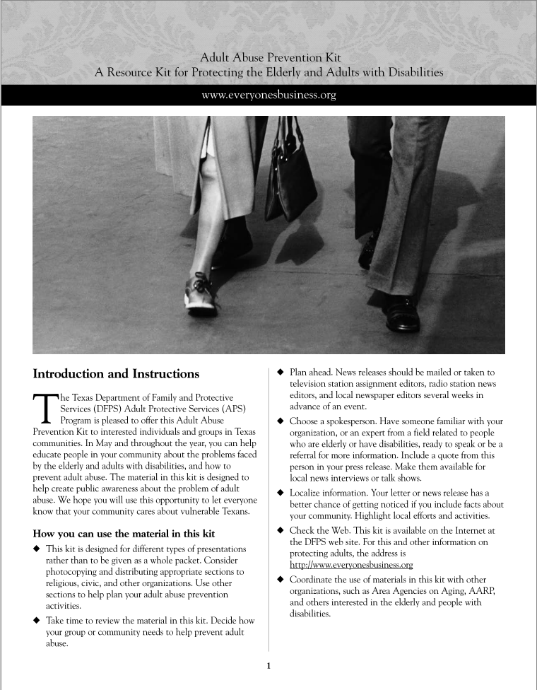

RESOURCES
Adult Abuse Prevention Kit
A Resource Kit for Protecting the Elderly and Adults with Disabilities

Slide 17

Child Protective Services
What is CPS
The CPS investigation
Other Hats of CPS
When and where to report
Trauma Informed Care Training

Slide 18

What is CPS?
An agency that investigates allegations of child abuse and neglect by parents or other family or household members.
If needed, CPS may refer parents to services for help. These services may include counseling, day care, homemaker services, evaluation, treatment, and parenting classes.

Slide 19
The CPS Investigation
Interviewing the child that may have been abused or neglected.
Making a reasonable effort to inform parents within 24 hours after an interview has taken place.
Discussing the report to get an explanation of any injuries, safety concerns, or risk of abuse or neglect to the child.
Gets criminal history information about people alleged to have abused or neglected the child.

Slide 20
The CPS Investigation
As necessary, the caseworker may also:
Interview other children
Visually examine children
Interview any other person alleged to have abused or neglected the child.
Interview anyone with information about the situation
Ask for access to mental health records
Ask for a medical, psychological, or psychiatric examination

Slide 21

Other Hats of CPS
Families Open Homes & Hearts with Kinship Care
Give Children a Safe Place to Live: Foster Care
Reuniting Families and Finding Children New Forever Homes
Work with Our Faith-Based Partners
  CHILD: Congregations Helping in Love and Dedication

Slide 22


Most Recent CPS Developments
As of March 17, 2015, two state agencies that work to protect the health and safety of Texans have teamed up and analyzed child abuse deaths [trauma] and have designed a plan to help prevent them.

Slide 23
Most Recent CPS Developments
Researchers found that during the three years studied, the deaths of 4,723 children were reported in Texas. Of those, 686 (14.5 %) were caused by abuse or neglect
Nearly 8% of all sleep related deaths were due to neglect.
About 6% of motor vehicle deaths were due to neglect, with most of those either children left in hot cars, or cases where an unsupervised child was struck and killed by a car.
8 children in the Dallas/Fort Worth area died in hot cars compared to 16 in the rest of the state.
San Antonio/New Braunfels (17), Midland/Odessa (five), and Beaumont/Port Arthur (nine) had higher than expected numbers of sleep related deaths due to neglect.
Many risk factors for child abuse deaths are also known risks for domestic violence.

Slide 24
Most Recent CPS Developments
The strategic plan calls for the development of programs in each of the areas targeted,
motor vehicle deaths, sleep related deaths, and child abuse deaths that can be correlated to domestic abuse
The study found that two thirds of mothers whose children suffered from abuse or neglect received Women, Infants, and Children (WIC) benefits while pregnant. So the study recommends a pilot in WIC clinics to train clinic employees.
http://www.dfps.state.tx.us/documents/about/News/other_news/DFPS_DSHS_Strategic_Plan_2015.pdf

Slide 25
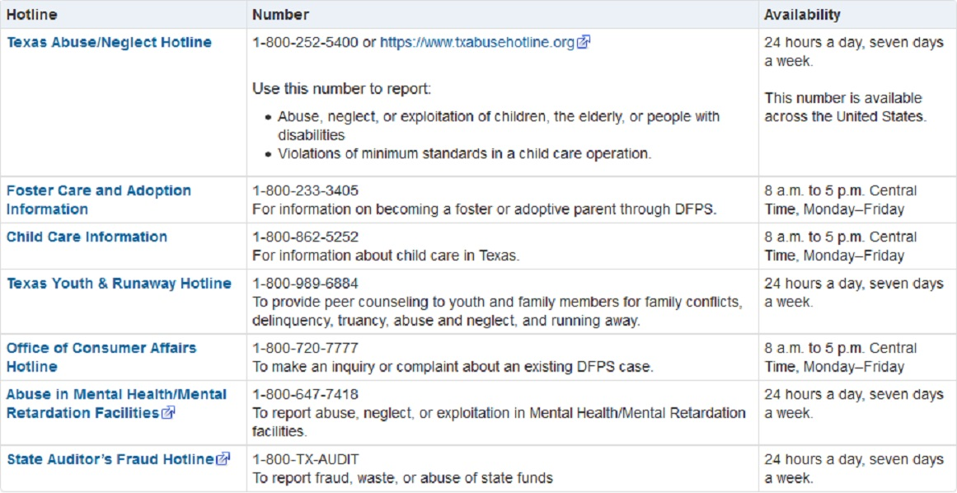
When and Where to Report or Seek for Assistance

Slide 26
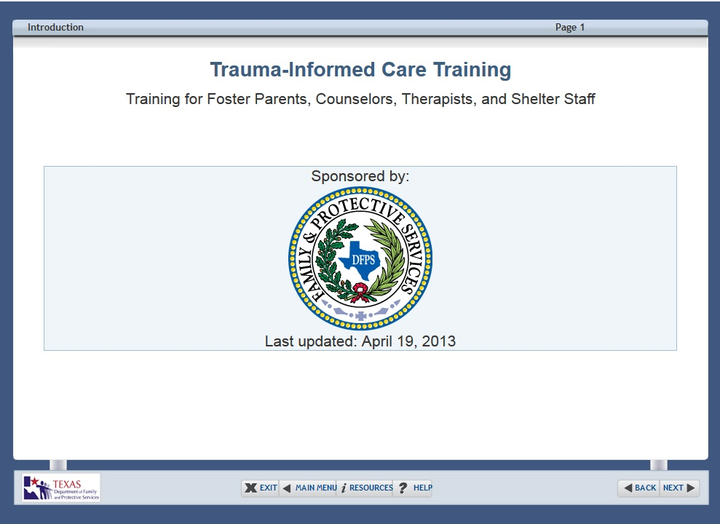
Trauma Informed Care Training
The Department of Family and Protective Services (DFPS) recognizes the long-term effects of adverse childhood experiences. The need to address trauma is increasingly viewed as an important component of effective service delivery in medical facilities.

Slide 27
Trauma Informed Care Training
In order to receive credit for the training, you must:
Complete the whole training.
Make at least a 70% on the post-test.
Print the Certificate of Completion of Trauma Informed Care Training at the end of the training.
Provide a copy of the Certificate of Completion of Trauma Informed Care Training
After you complete the training, you are able to download a copy of the DFPS Trauma Informed Care training PowerPoint Presentation to use as a guide.

Slide 28
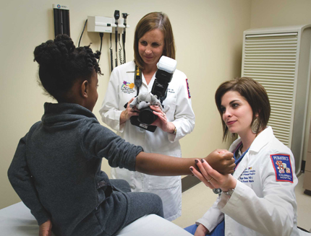
Advocates and researchers have called for collaboration between professionals in the domestic violence and medical fields to ensure safety of the entire family.
Most of the collaborative efforts in the United States focus on training medical professionals to increase their knowledge of domestic violence, change attitudes and beliefs about it, and revise screening procedures to identify families for domestic violence.
Does exposure to domestic violence indicate a form of child maltreatment?
Overlap

Slide 29

Criminal behavior includes but is not limited to uninvited physical contact such as striking, kicking, biting, sexual coercion and abuse, marital rape, intimidation by stalking, computer hacking, and criminal isolation.
Non- criminal behavior includes but is not limited to being denied access to friends or other social contacts.
Shadowing, restricting the use of the telephone by securing phones in a locked or temporary removal during the time the abuser is away.
Denying access to family finances.
There are two types of domestic violence behavior: Criminal and non-criminal.
Domestic Violence

Slide 30
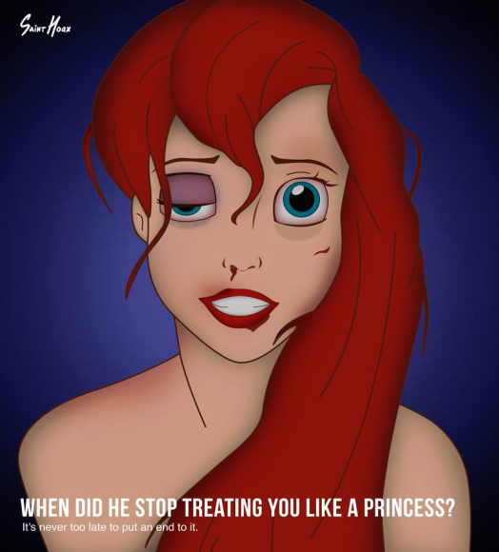
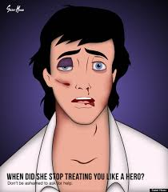
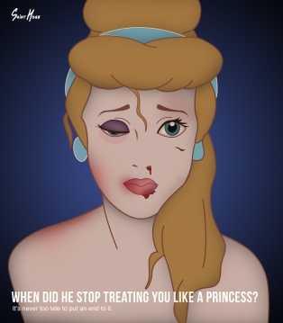


Domestic Violence
Every day 4 women, 1 man and almost 5 children die as a result of domestic violence.
1 in every 4 women will experience domestic violence in her lifetime.
Females ages 20-24 years of age are at the greatest risk for intimate partner abuse.
In 2005, 389,100 women and 78, 180 men were victimized by an intimate partner

Slide 31
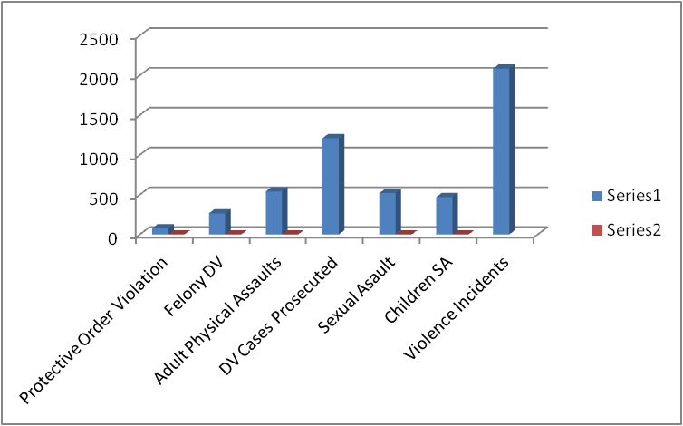
Domestic Violence Statistics in Cameron County
2013 Cameron County
Protective Order Violation | 77 | ↑44.40%
Felony DV | 265 | ↑26.50%
Adult Physical Assaults | 540 | ↑15%
DV Cases Prosecuted | 1210
Sexual Asault | 519 | ↑67.50%
Children SA | 470 | ↑78.10%
Violence Incidents | 2083

Slide 32
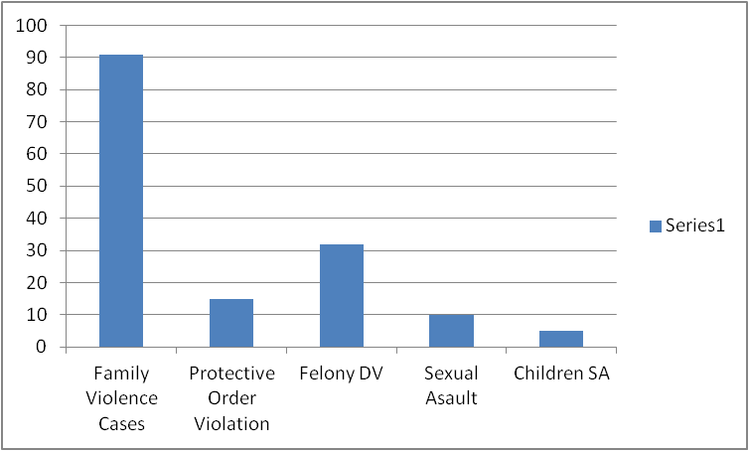
Domestic Violence Statistics in
Willacy County
2014 Willacy County
Family Violence Cases | 91
Protective Order Violation | 15
Felony DV | 32
Sexual Asault | 10
Children SA | 5

Slide 33


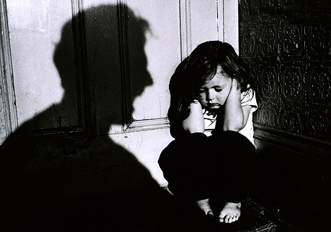




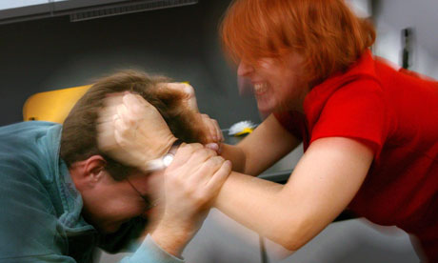



The Domestic Violence and CPS/APS overlap

Slide 34



The Rationale of a Plan and the Local Options
The life of a relationship can be filled with all the emotional components that make for a good partnership. When the partnership is no longer workable, a couple may decide to split and agree to disagree amicably or with animosity.
The life of a relationship can also be filled with the ugliness of power and control and violence.
956-423-9305 or 1-866-423-9304
(956) 664-2826
(956) 544-7412

Slide 35
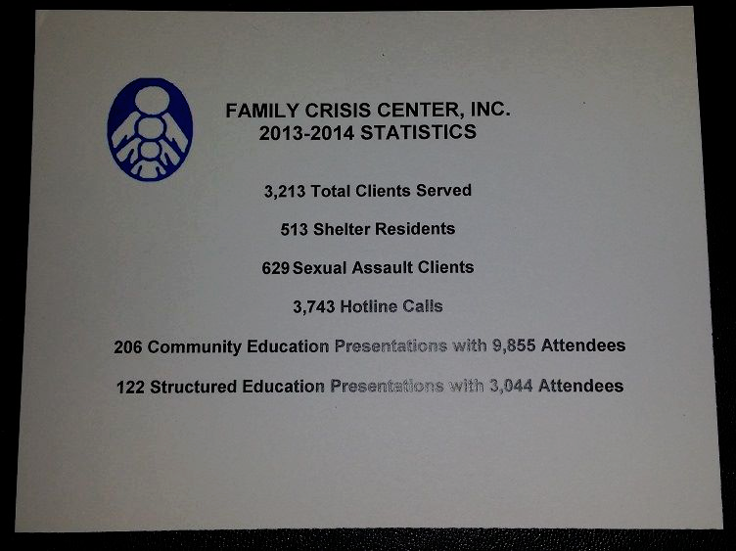
Family Crisis Center Data

Slide 36
April is National Sexual Assault Awareness Month and October is Domestic Violence Awareness Month.
There are 720 hours in the month of April and 754 hours in the month of October, a total of 1464 hours.
As many as 115 children are abused in one hour. That is 168,360 children too many.
As many as 4 women , 1 man and almost 5 children die every 24 hours as a result of domestic violence. That is 610 people too many.

Slide 37

AWARENESS and KNOWLEDGE
74% of Americans are currently being abused or know someone who is. There are 8,760 hours in a year.
Shouldn’t we be more than aware every day of every week, of every month, of every year?

Slide 38

Knowledge Influences Professional Attitudes

